Slide 1
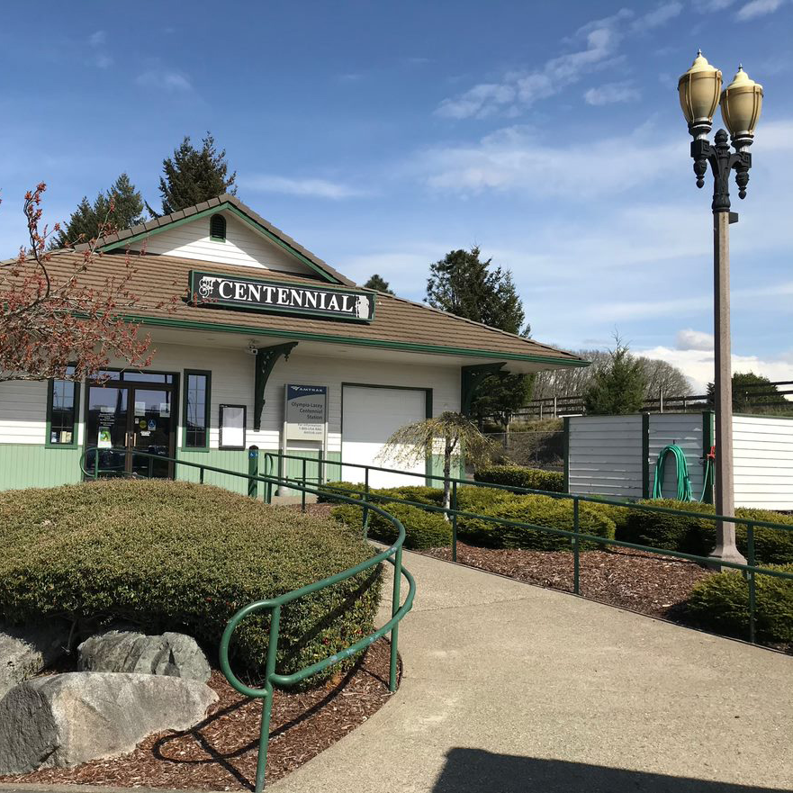
Olympia-Lacey Amtrak Station:
33 Continuous Years
Completely Staffed By Volunteers!
Lacey Historical Society
Sept. 8, 2026

Slide 2
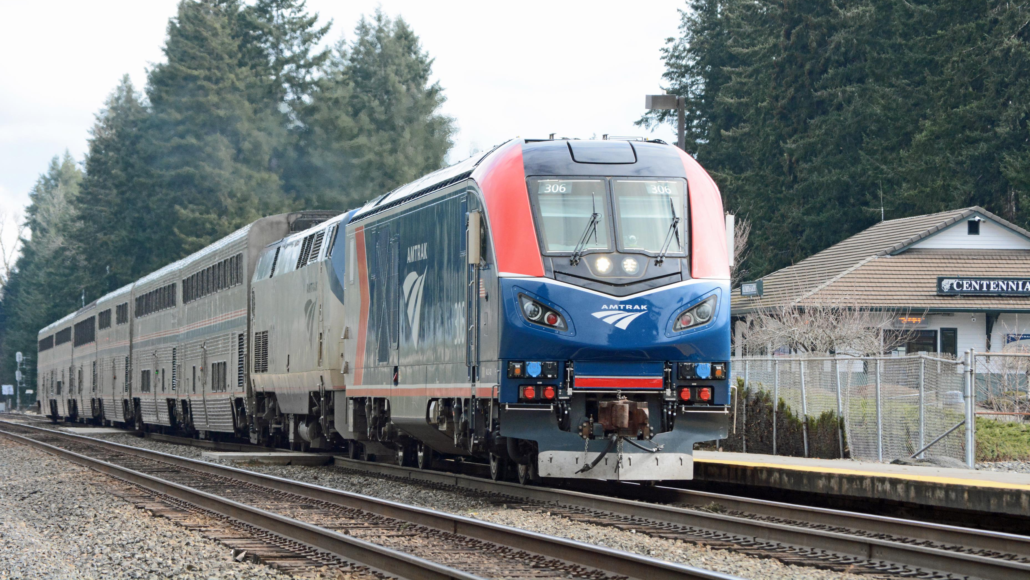
Olympia-Lacey
Coast Starlight

Slide 3
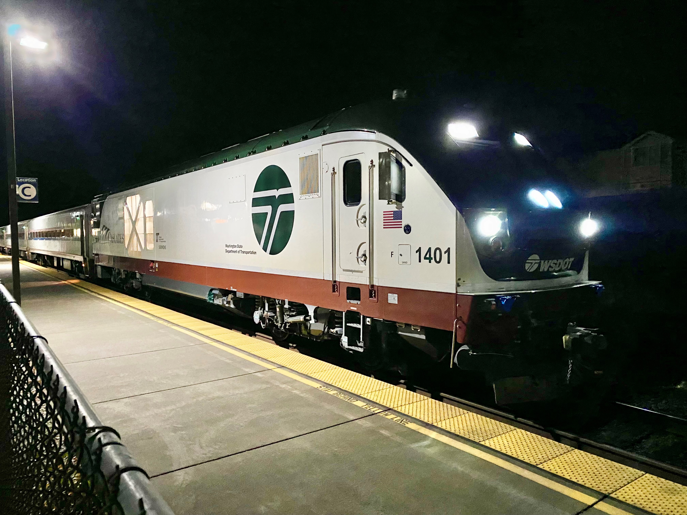
Olympia-Lacey
Amtrak Cascades

Slide 4
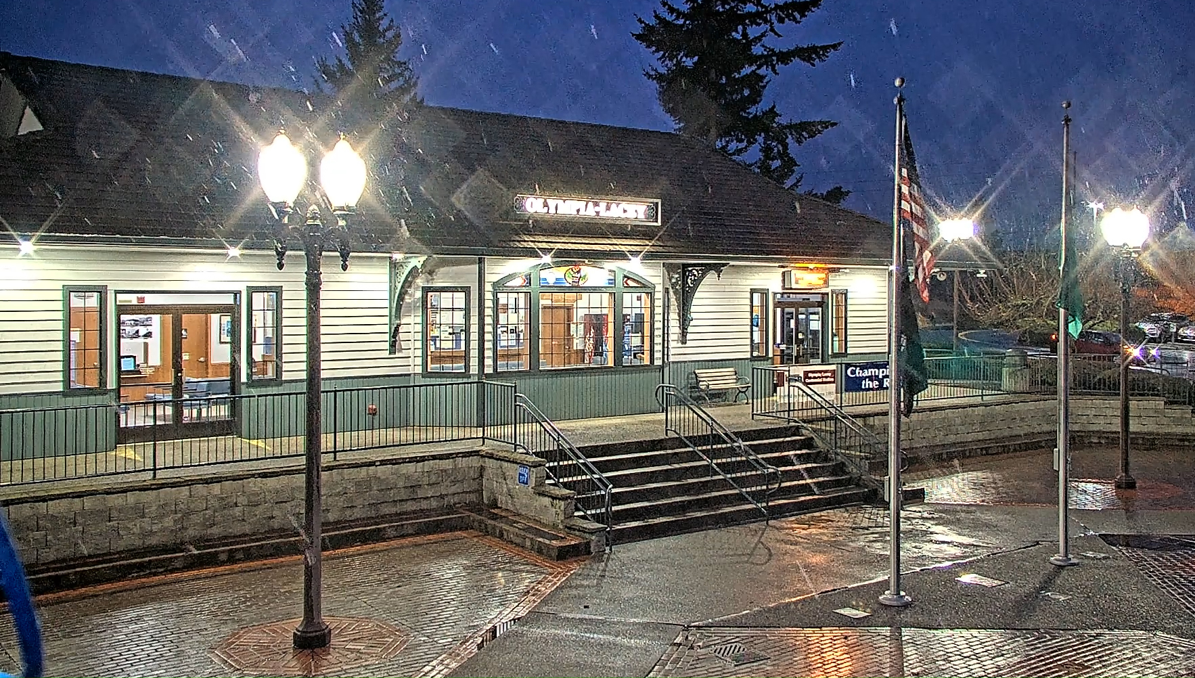

Slide 5
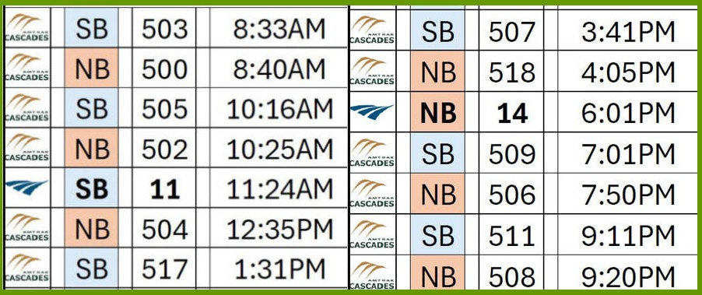
Fourteen Passenger Trains Daily!
Seven Northbound toward Seattle or Vancouver B.C., Seven Southbound to Portland or Eugene

Slide 6
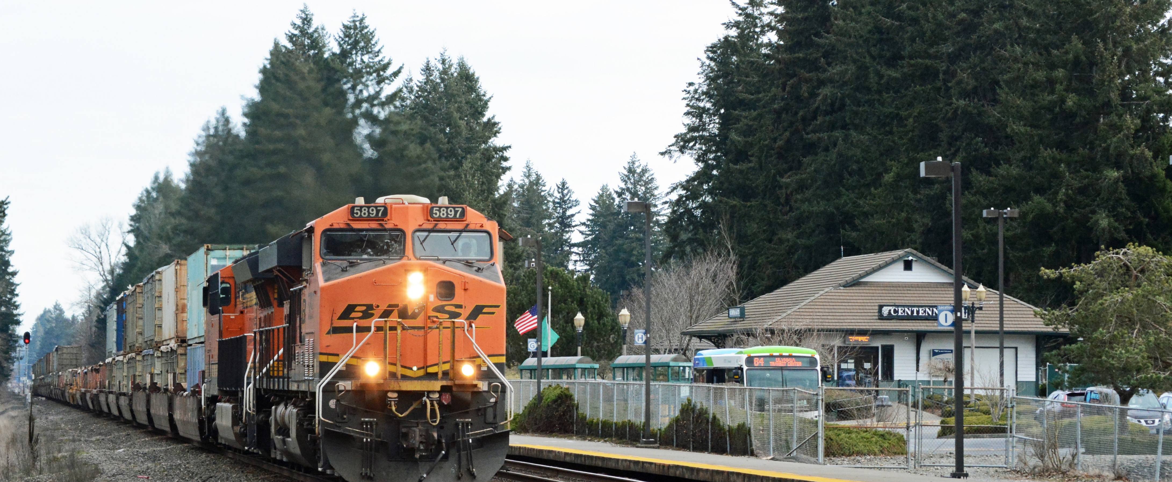
Located on Main 1 and Main 2, Longtime North-South Right of Way for BNSF and Union Pacific Freight Trains. About 40 freight trains/day.

Slide 7
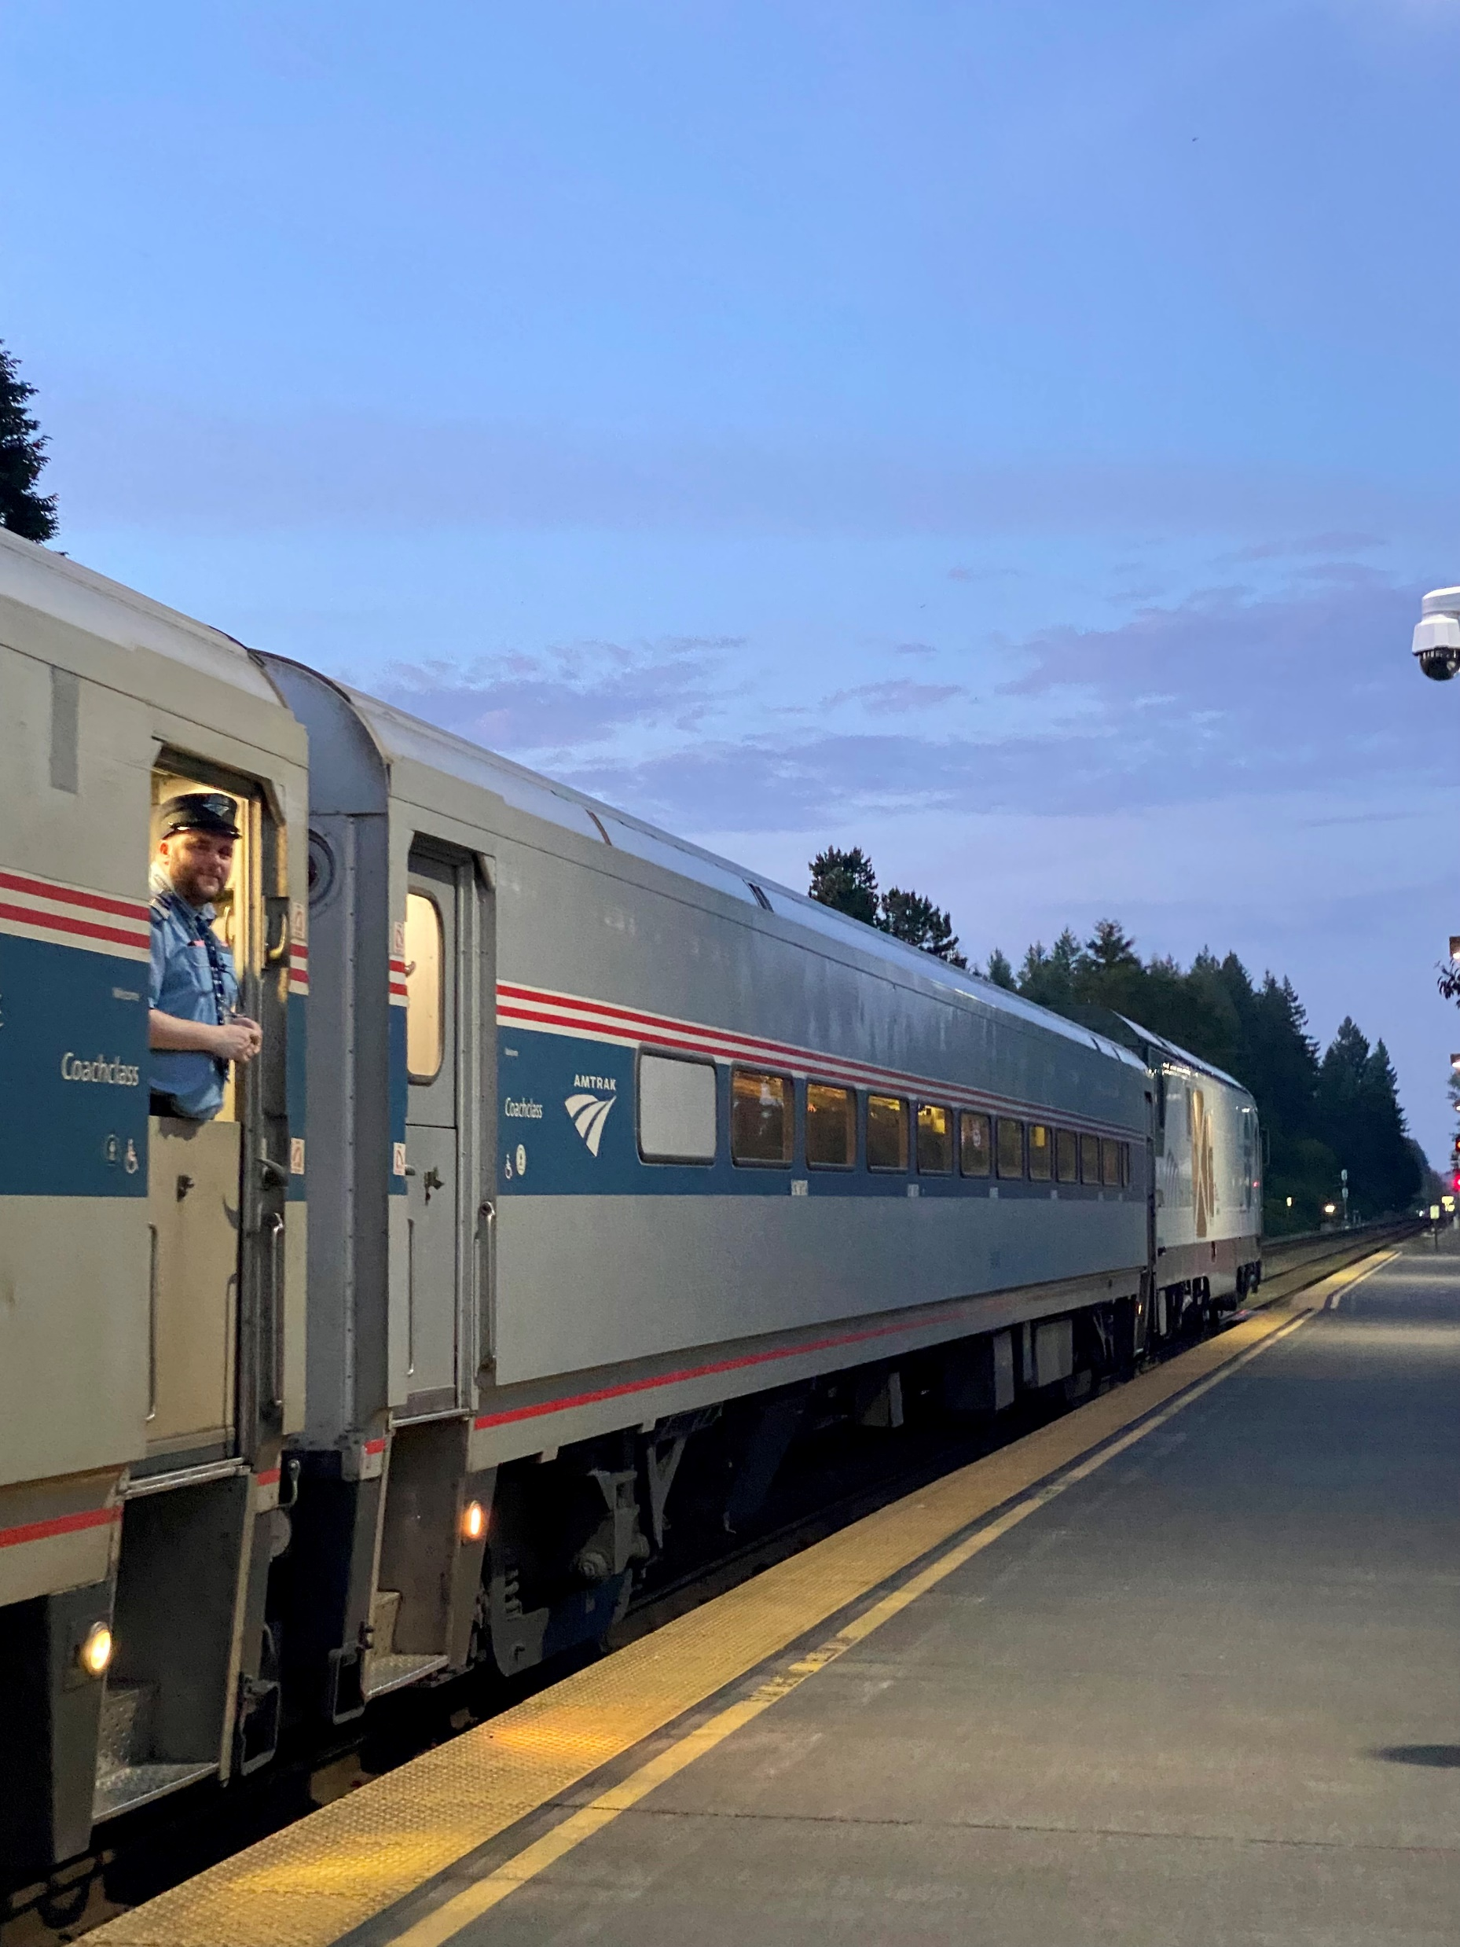
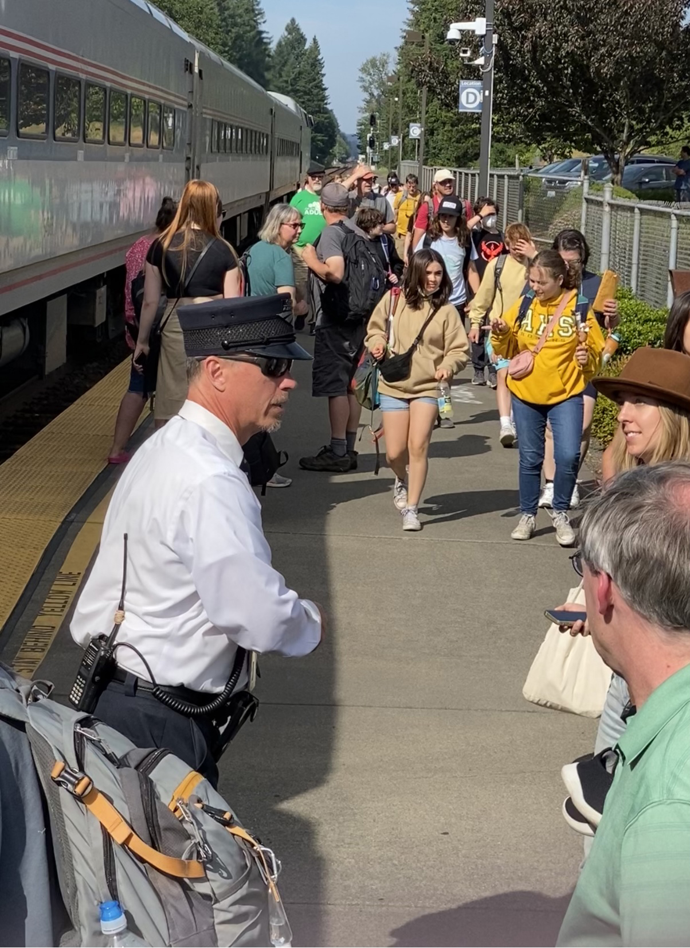
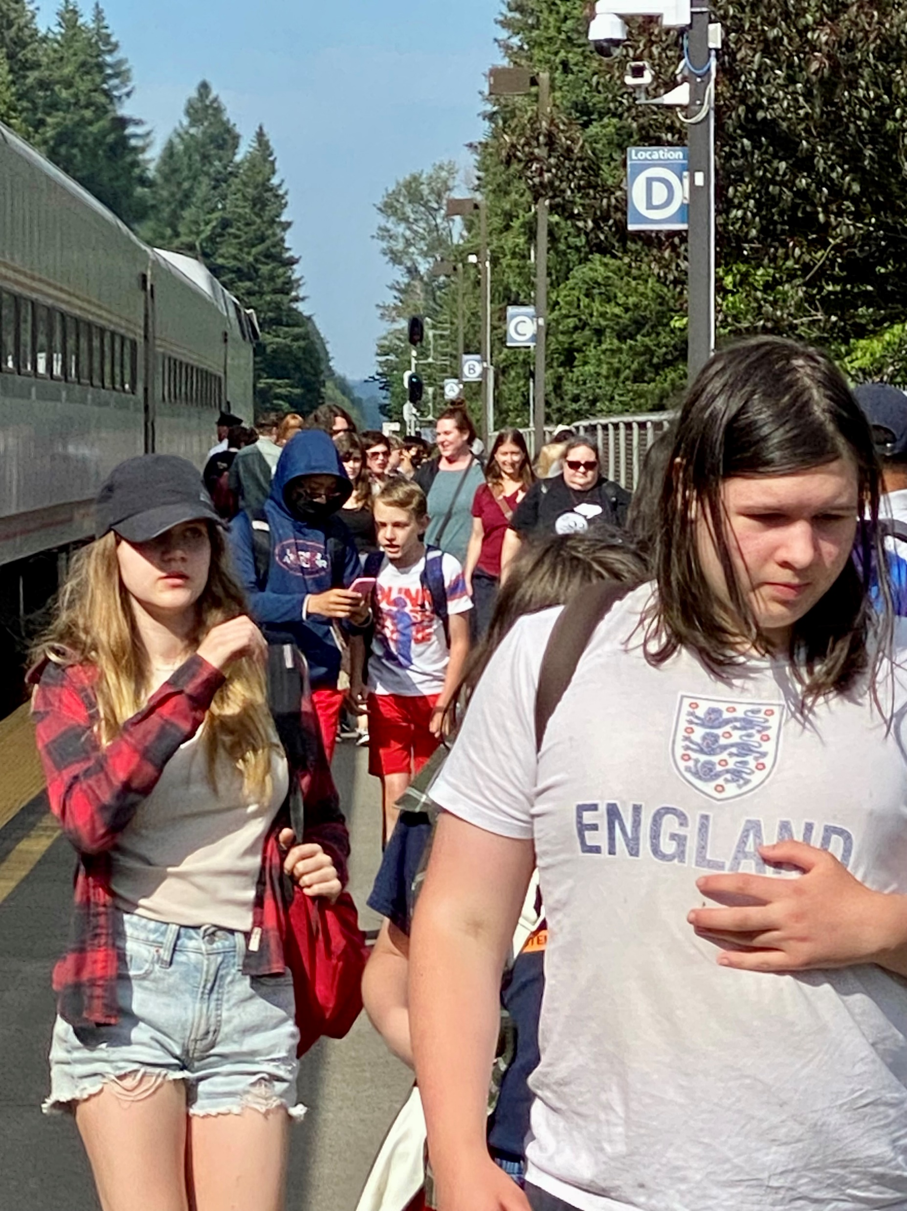

Slide 8
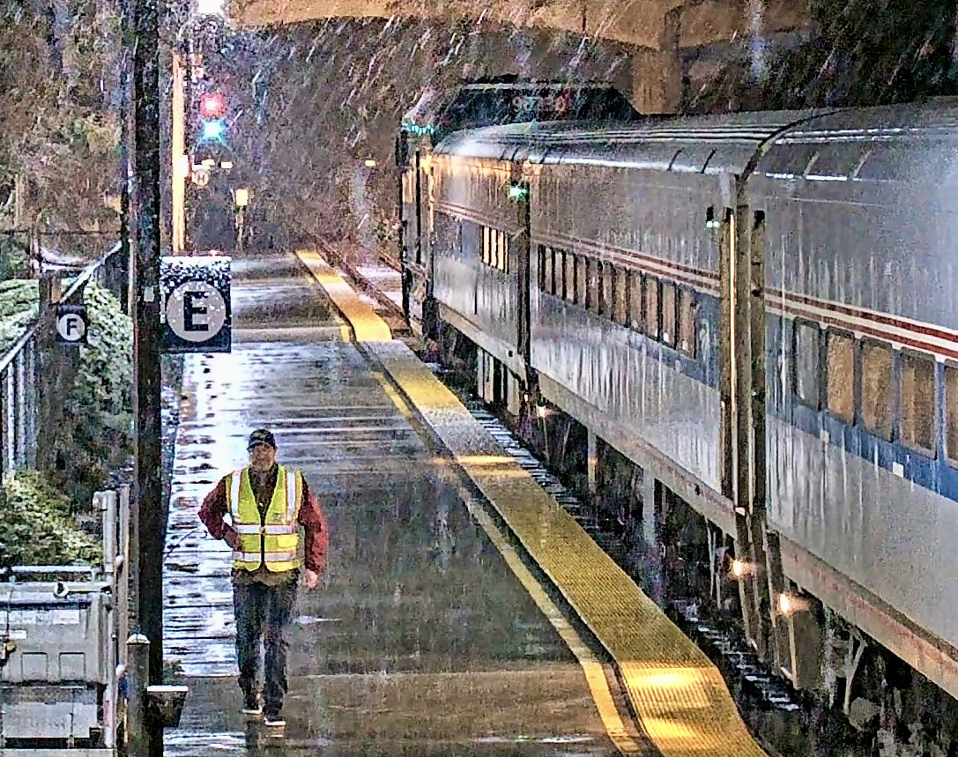

Slide 9
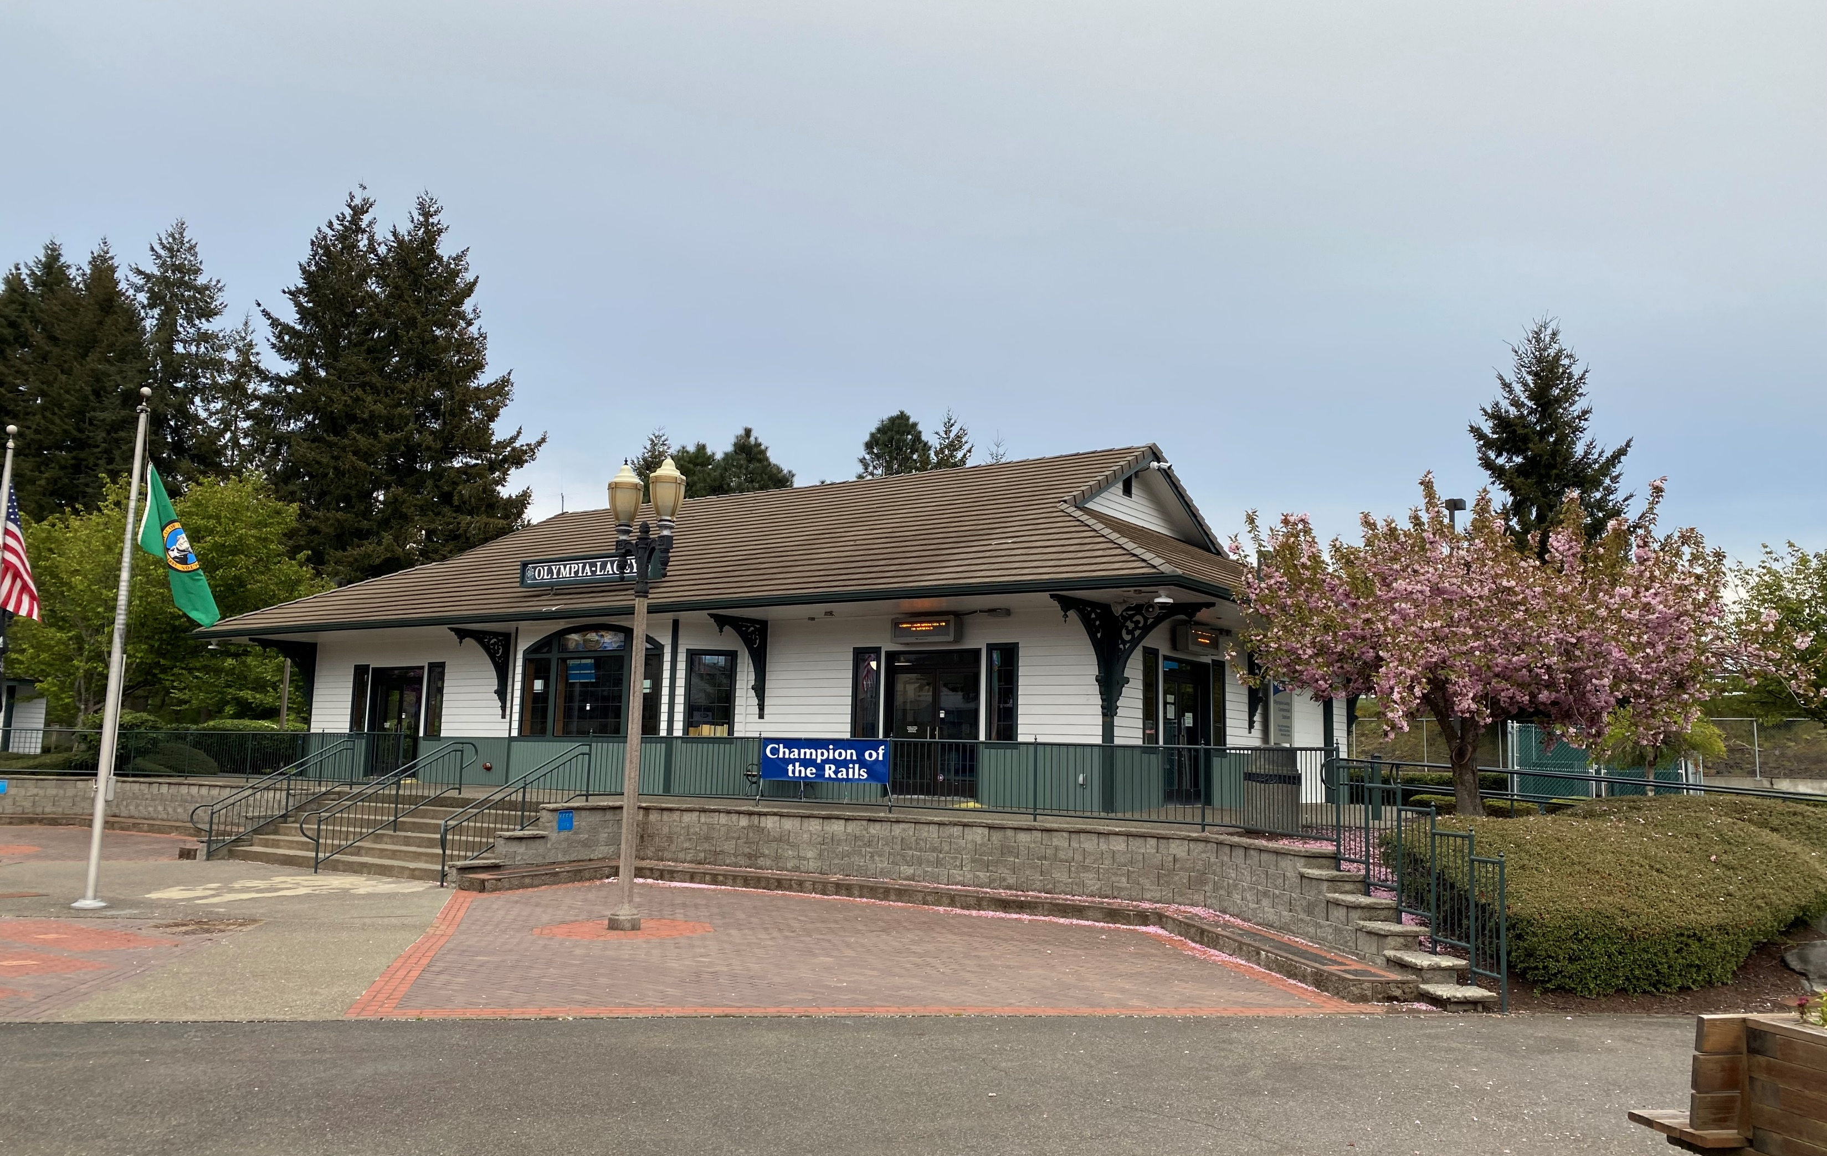

Slide 10
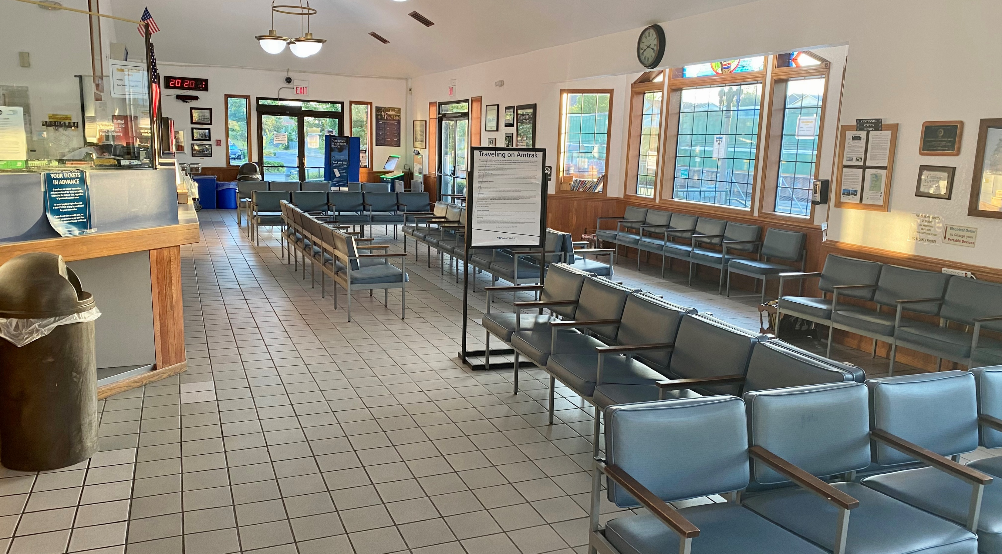

Slide 11
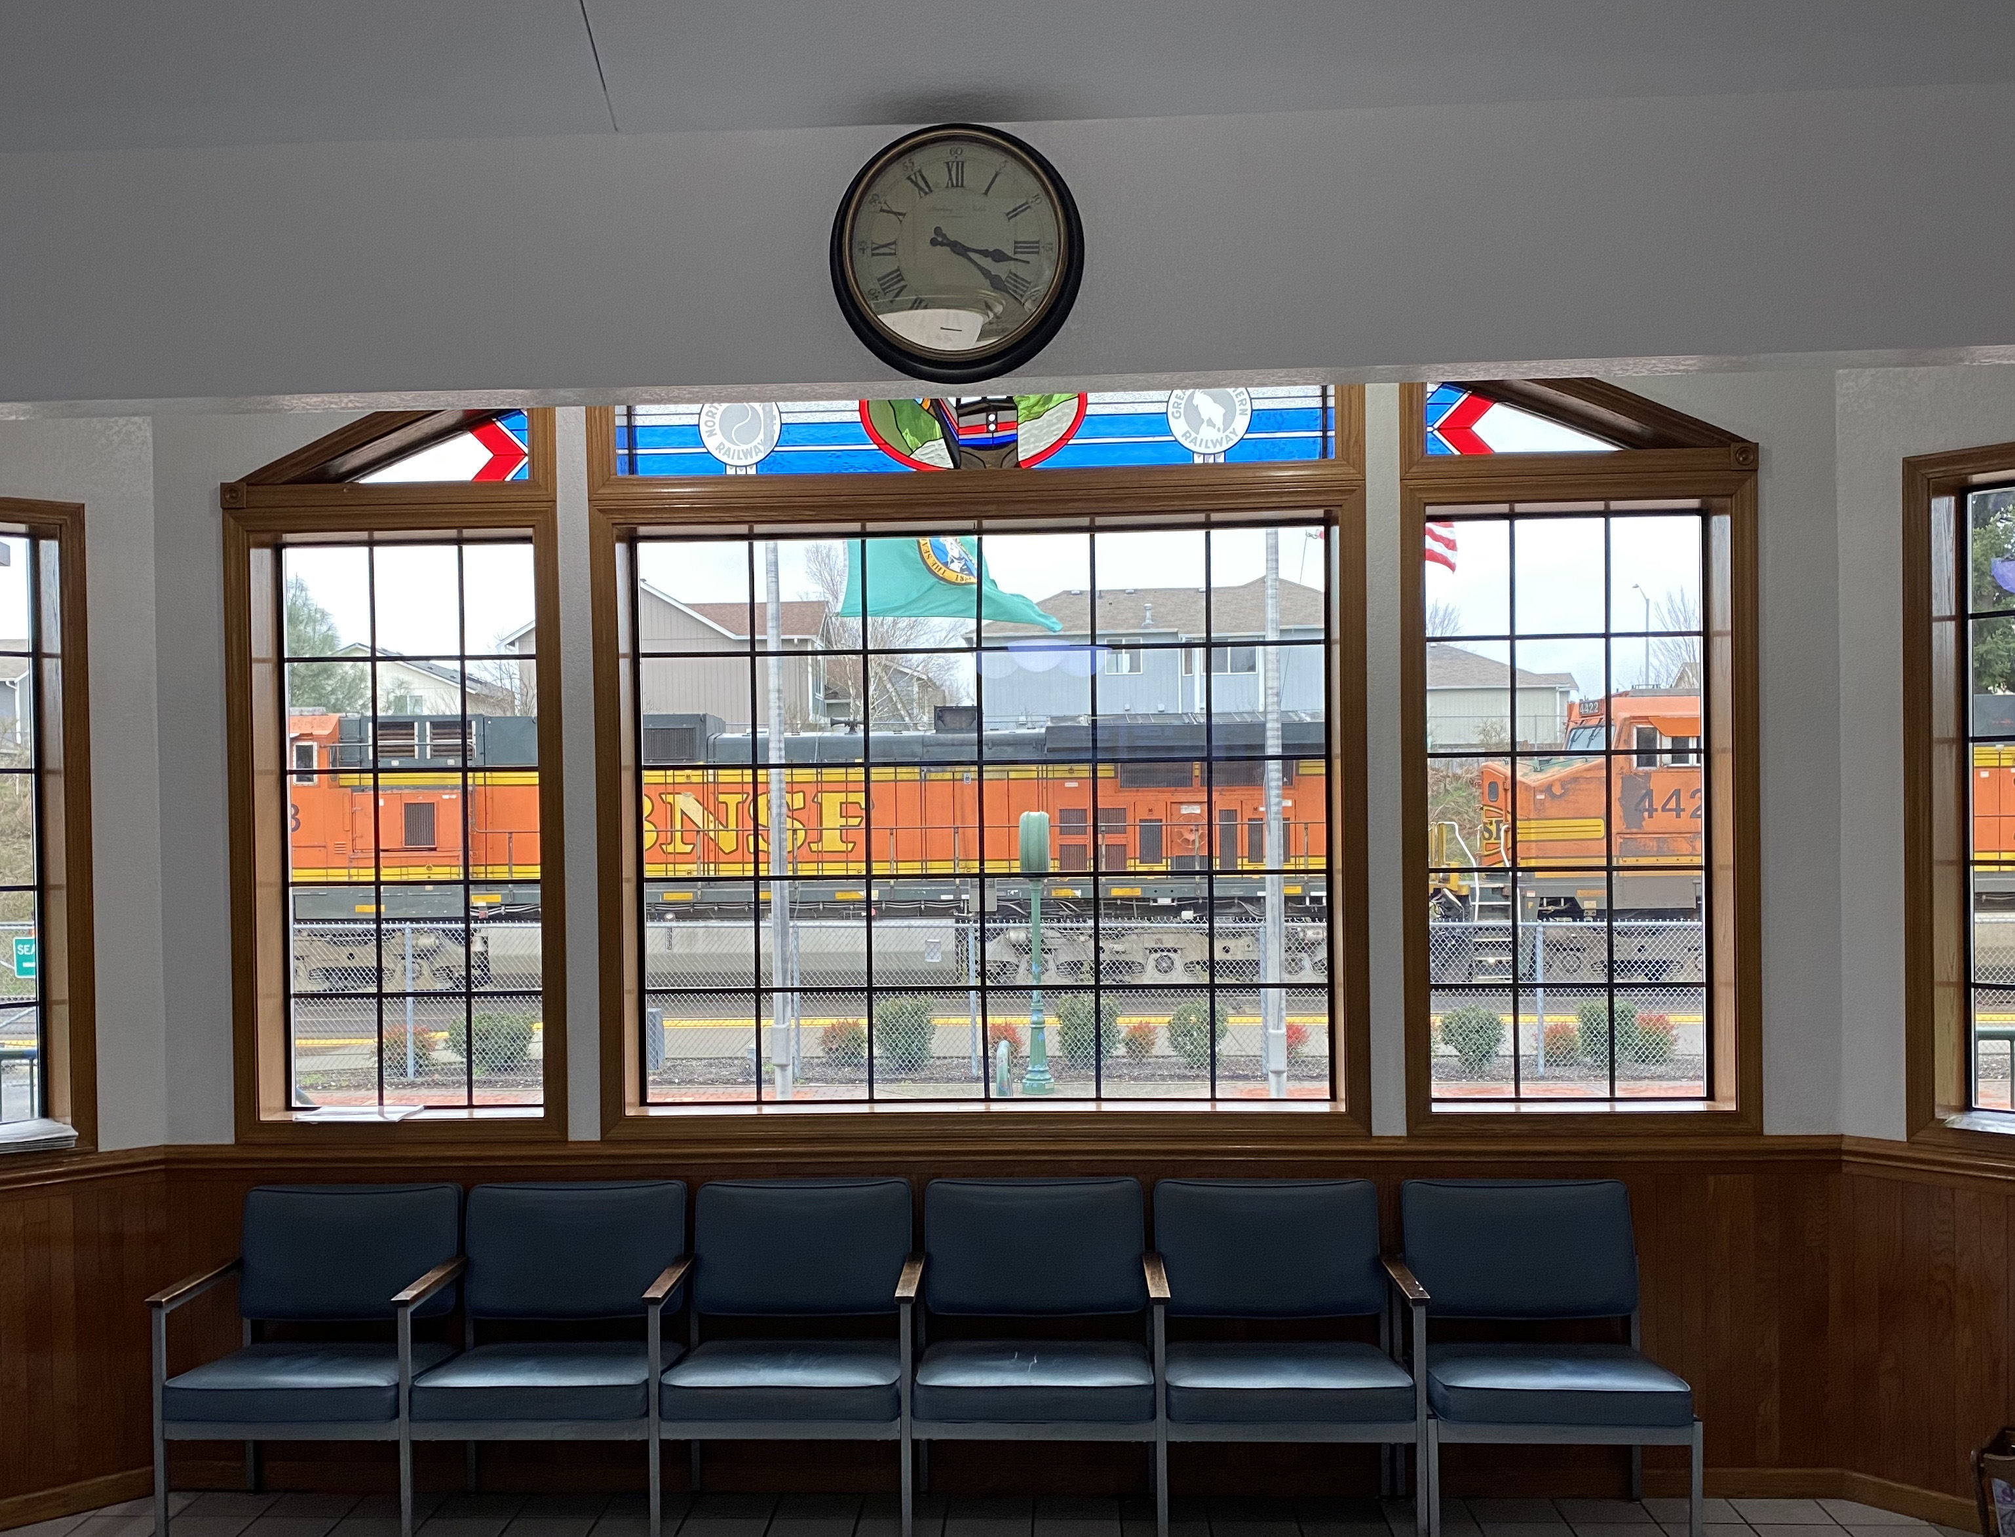
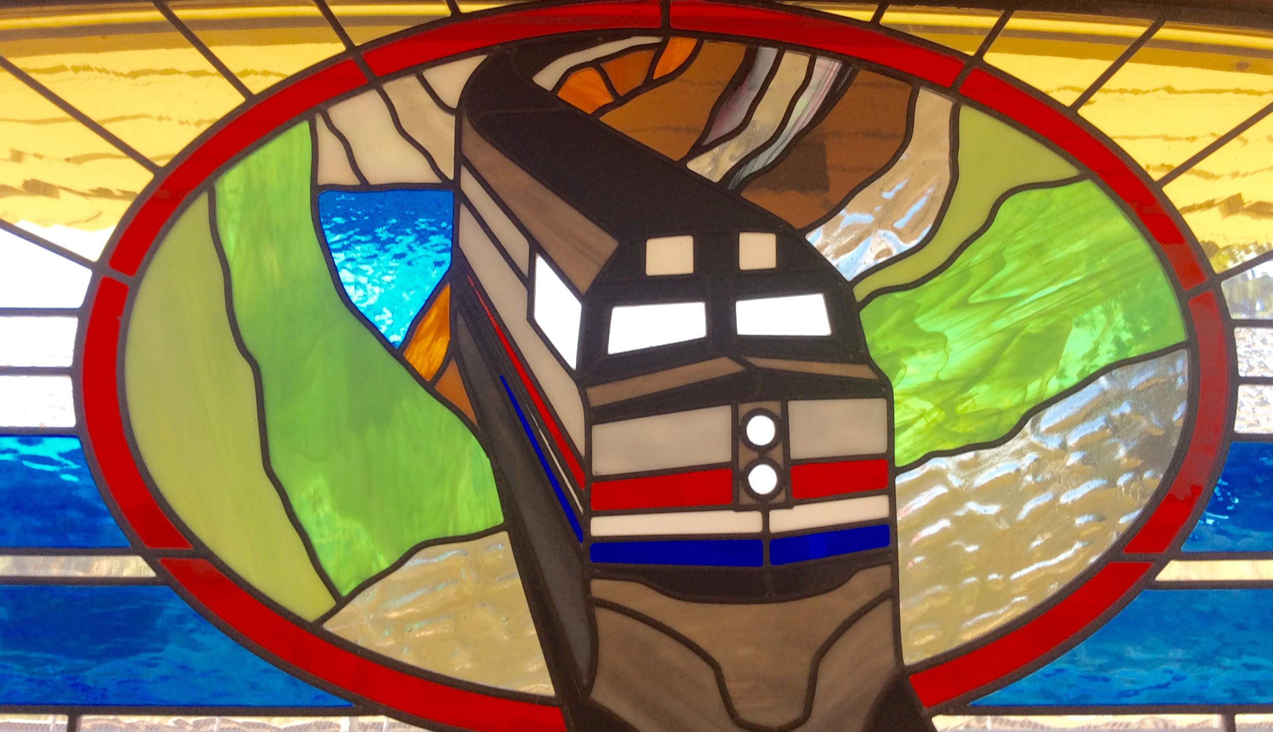
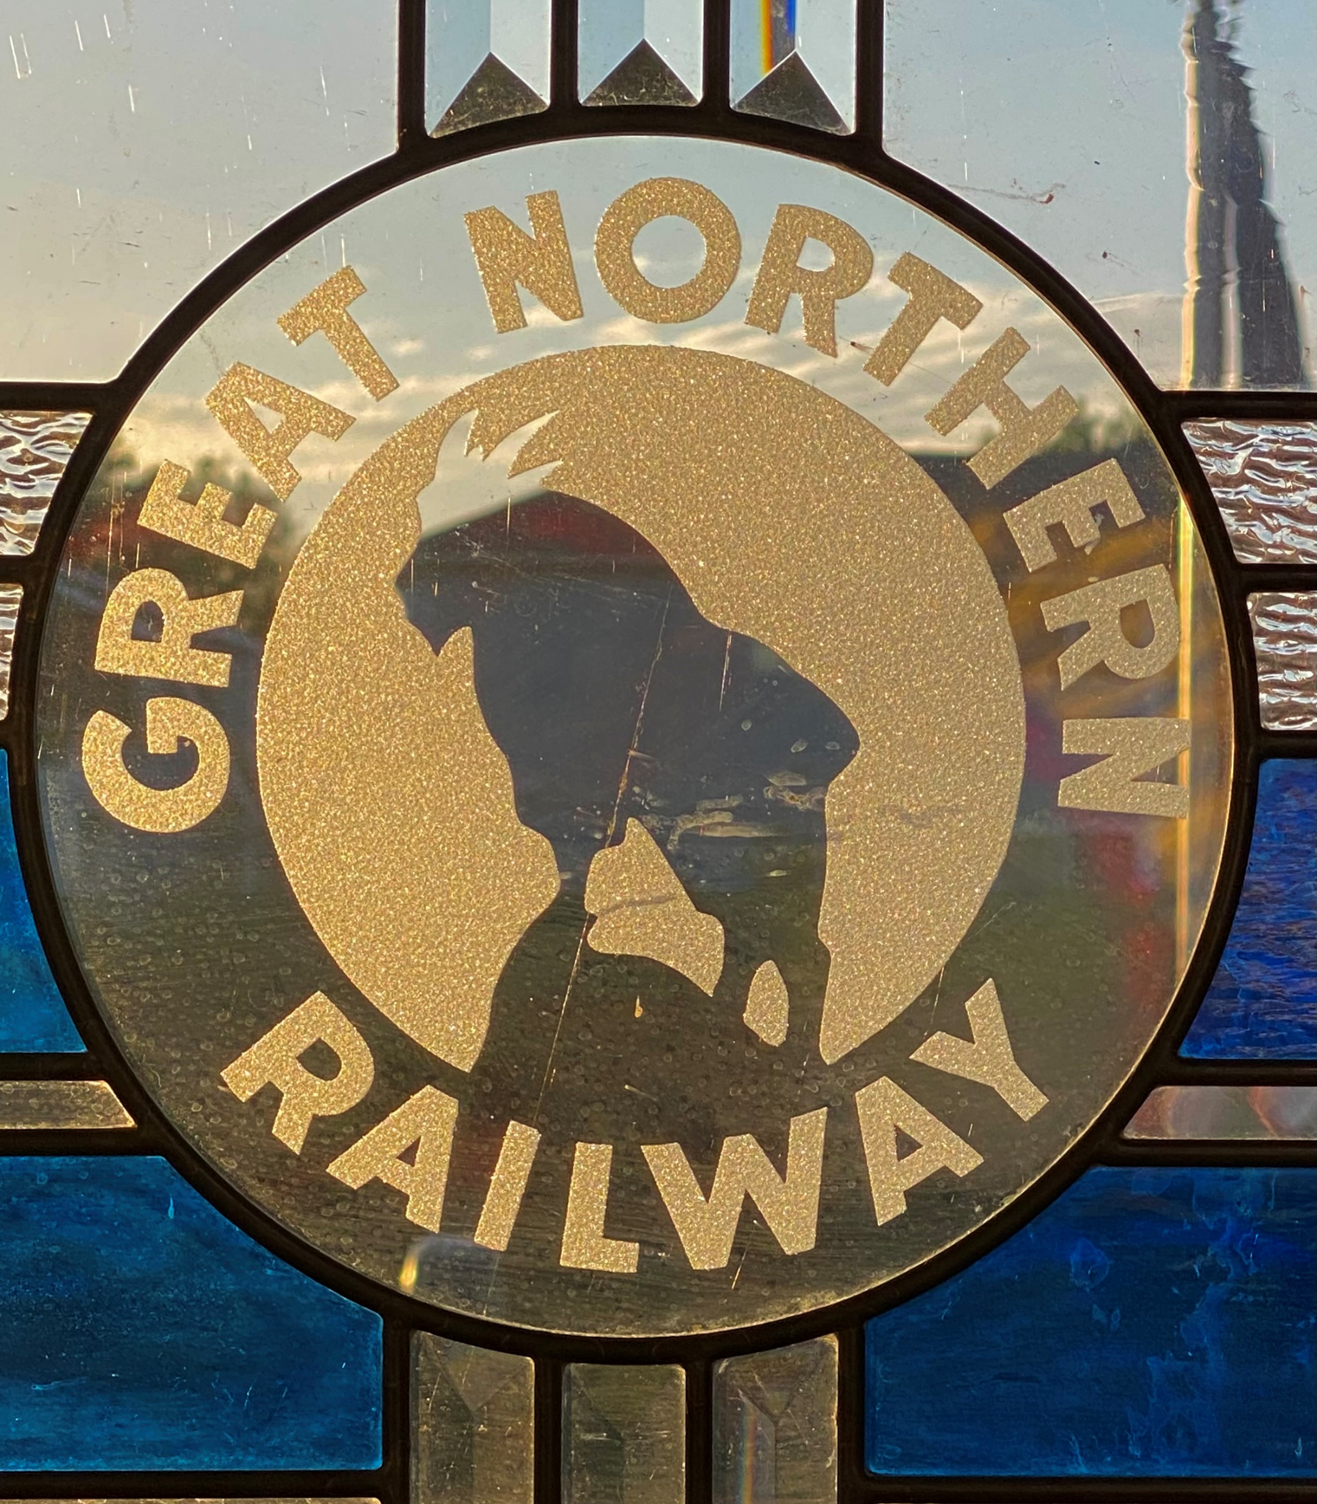
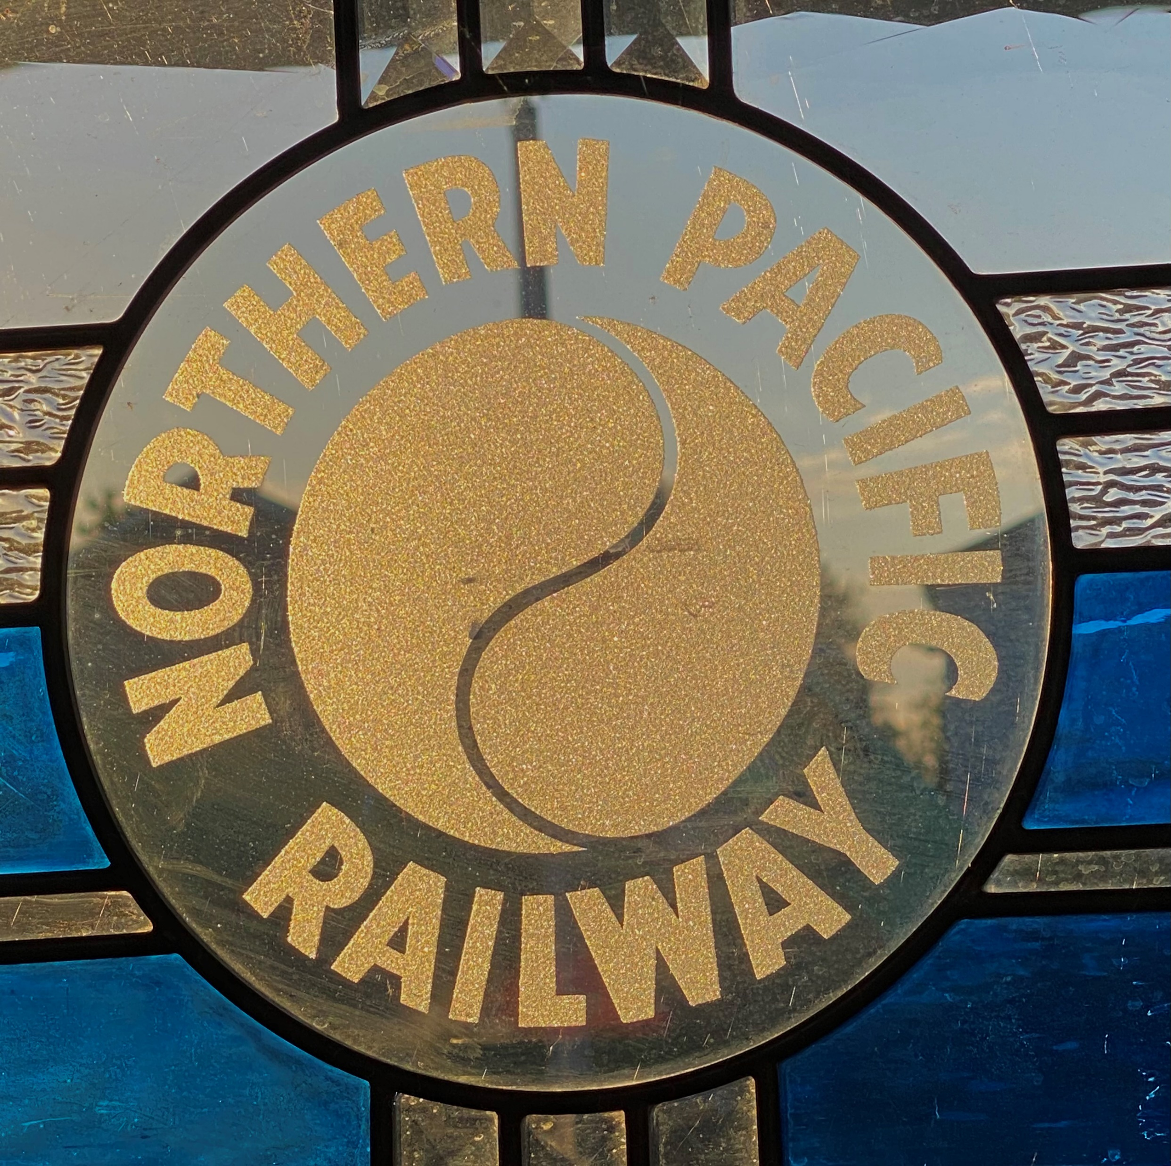
Stained Glass
Stained glass is courtesy of Tom Russell, Tacoma, the designer and creator who donated the glass.

Slide 12
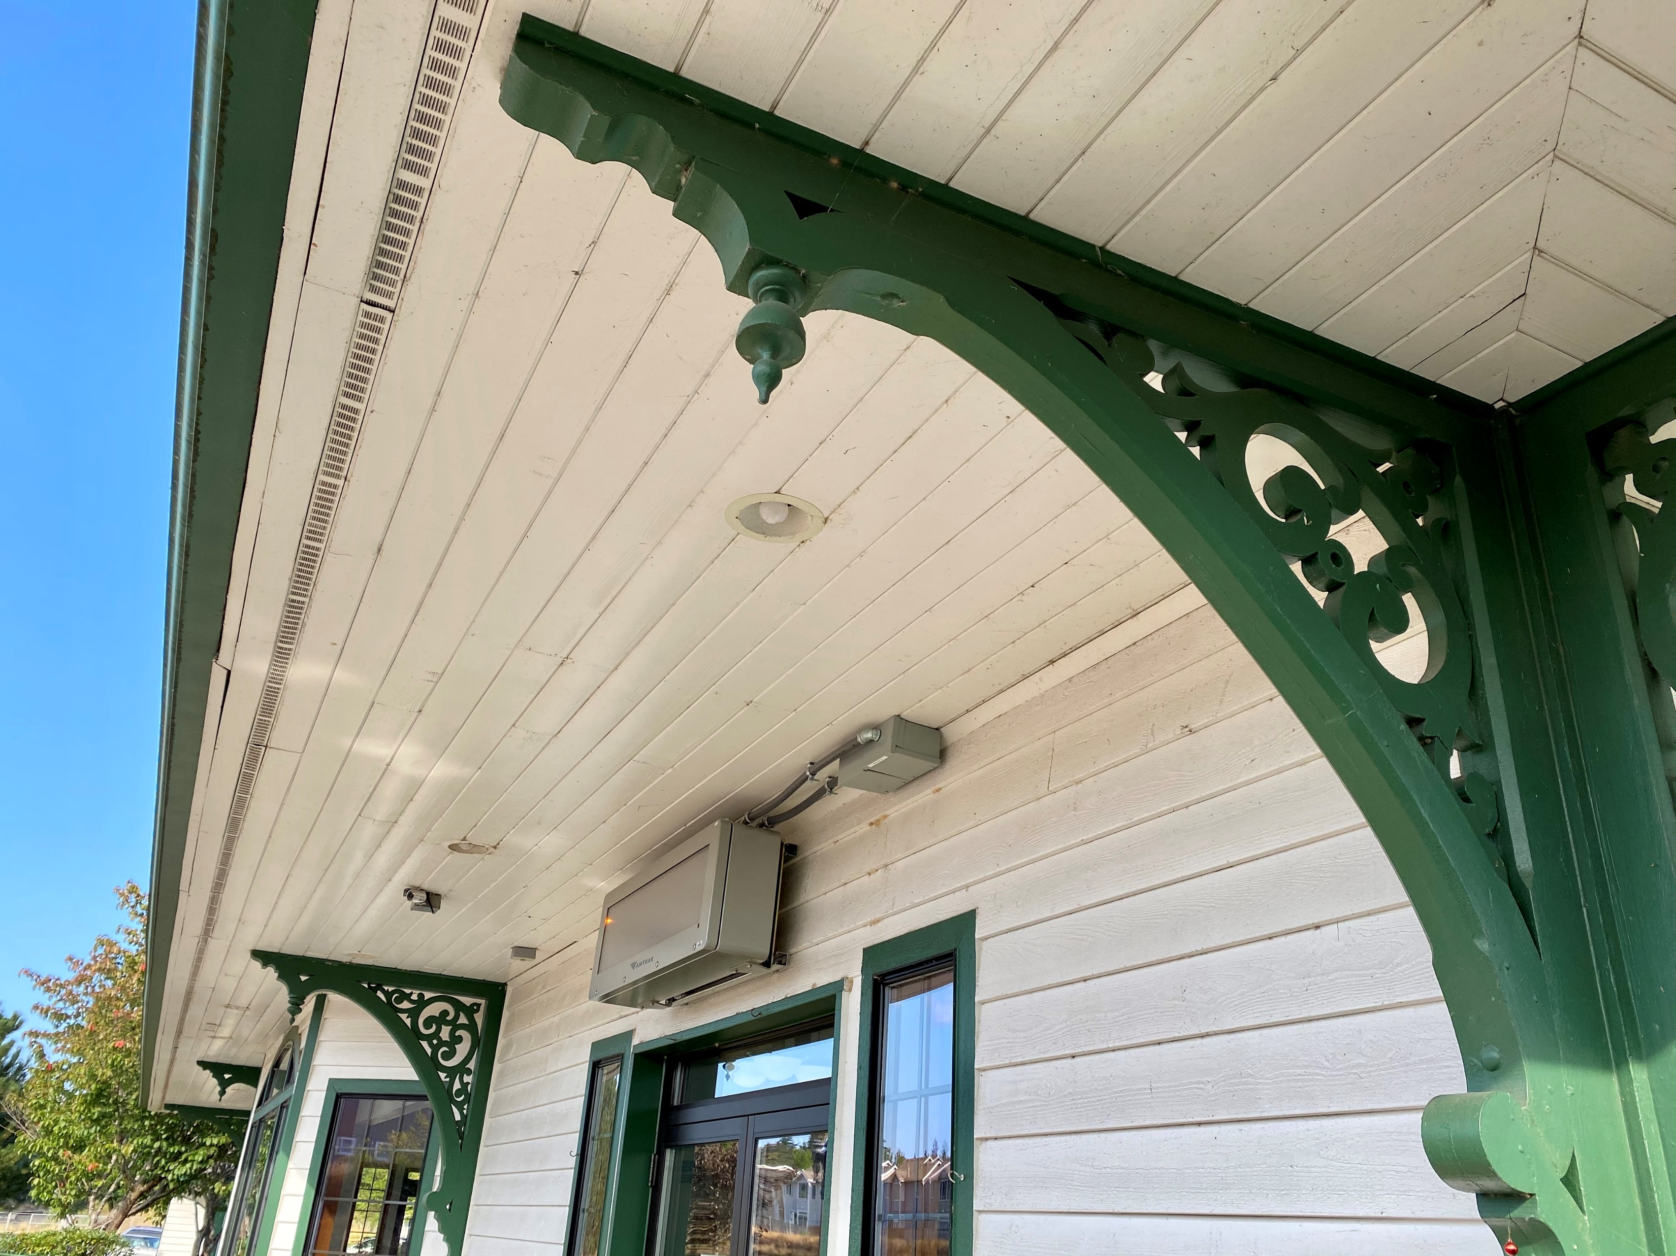
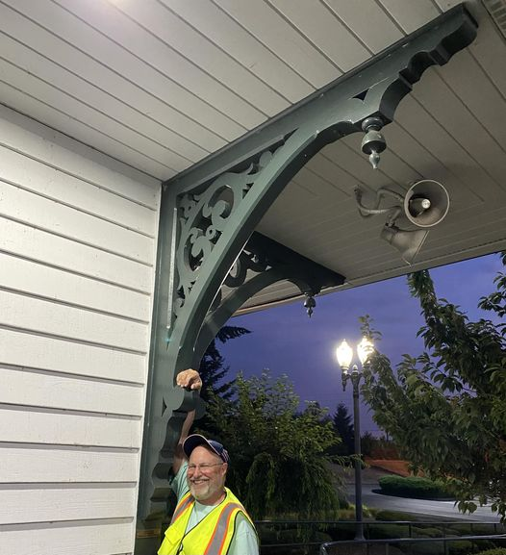
Antique
Corbels
150 years old, made of solid cypress.

Slide 13
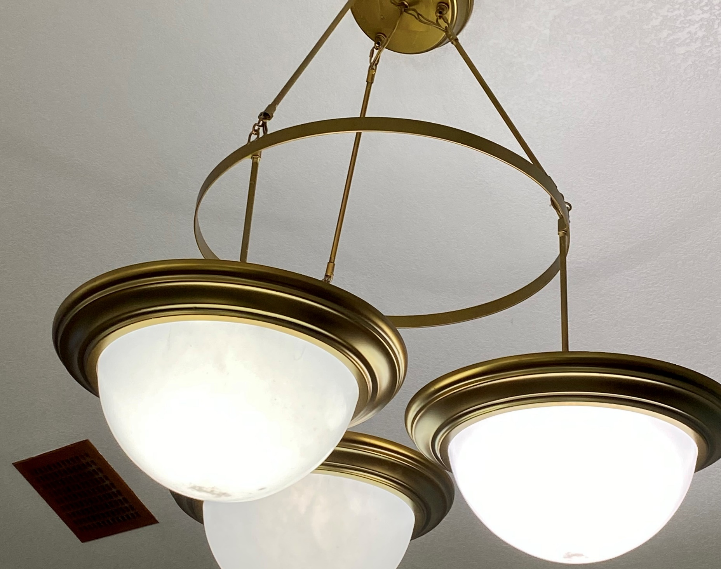
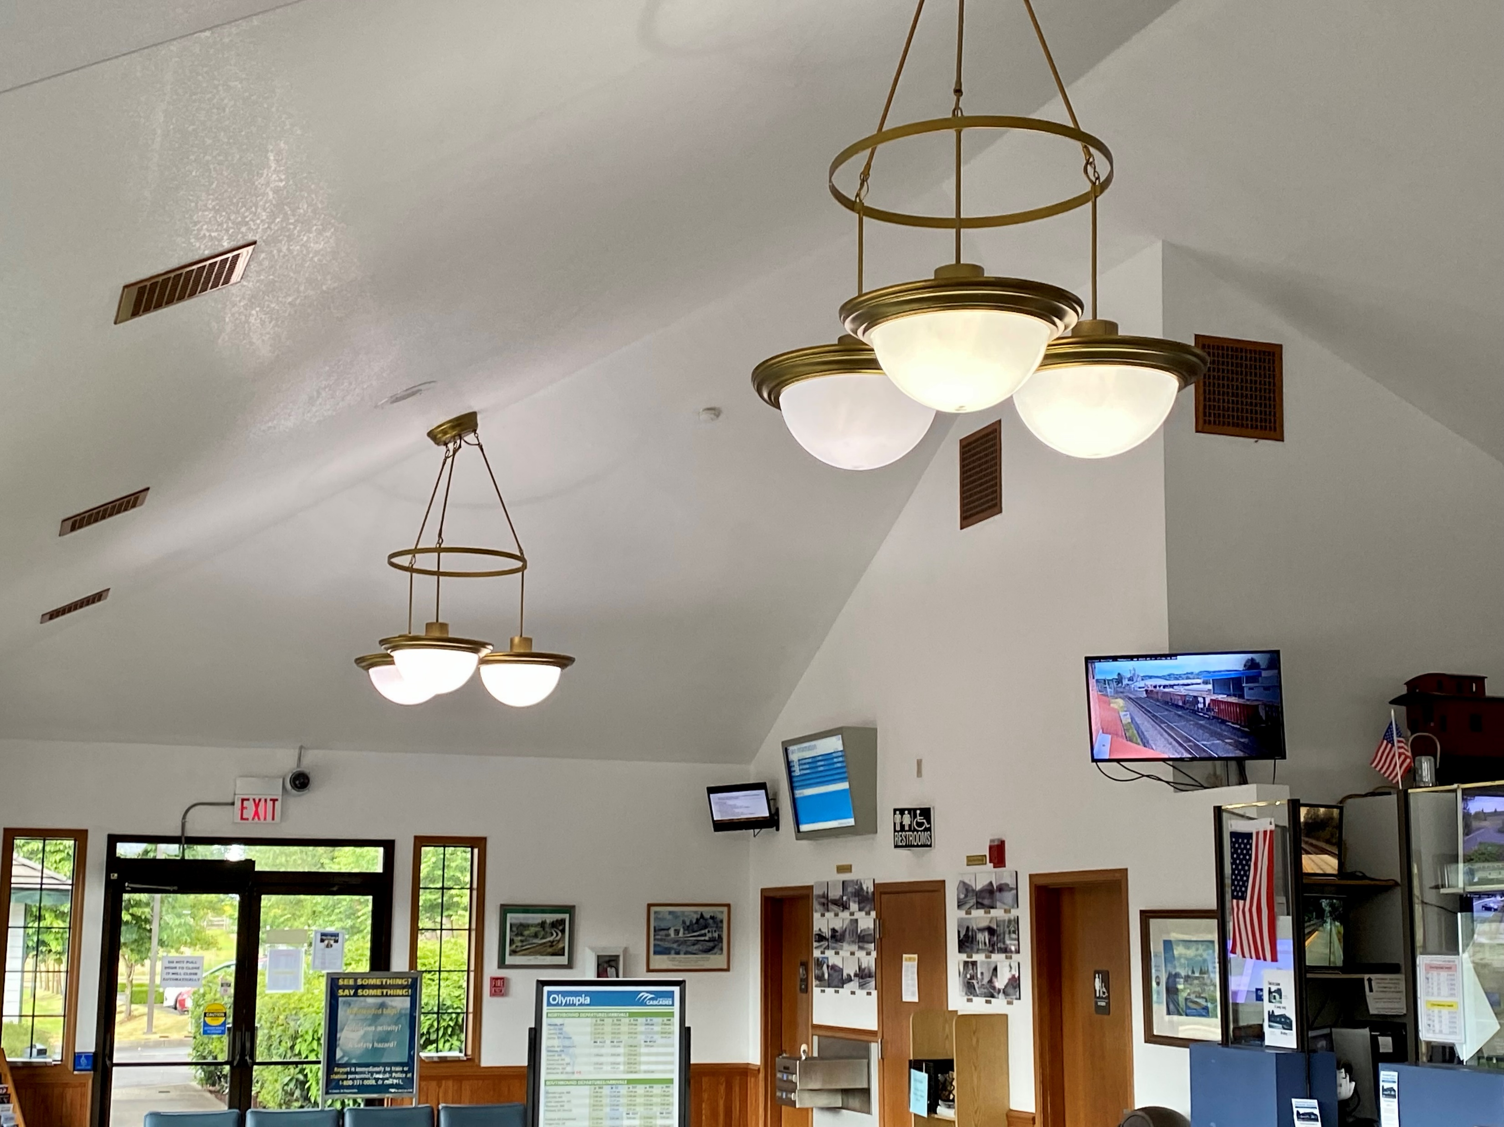
Light
Fixtures
Replicas of Grand Central Station

Slide 14
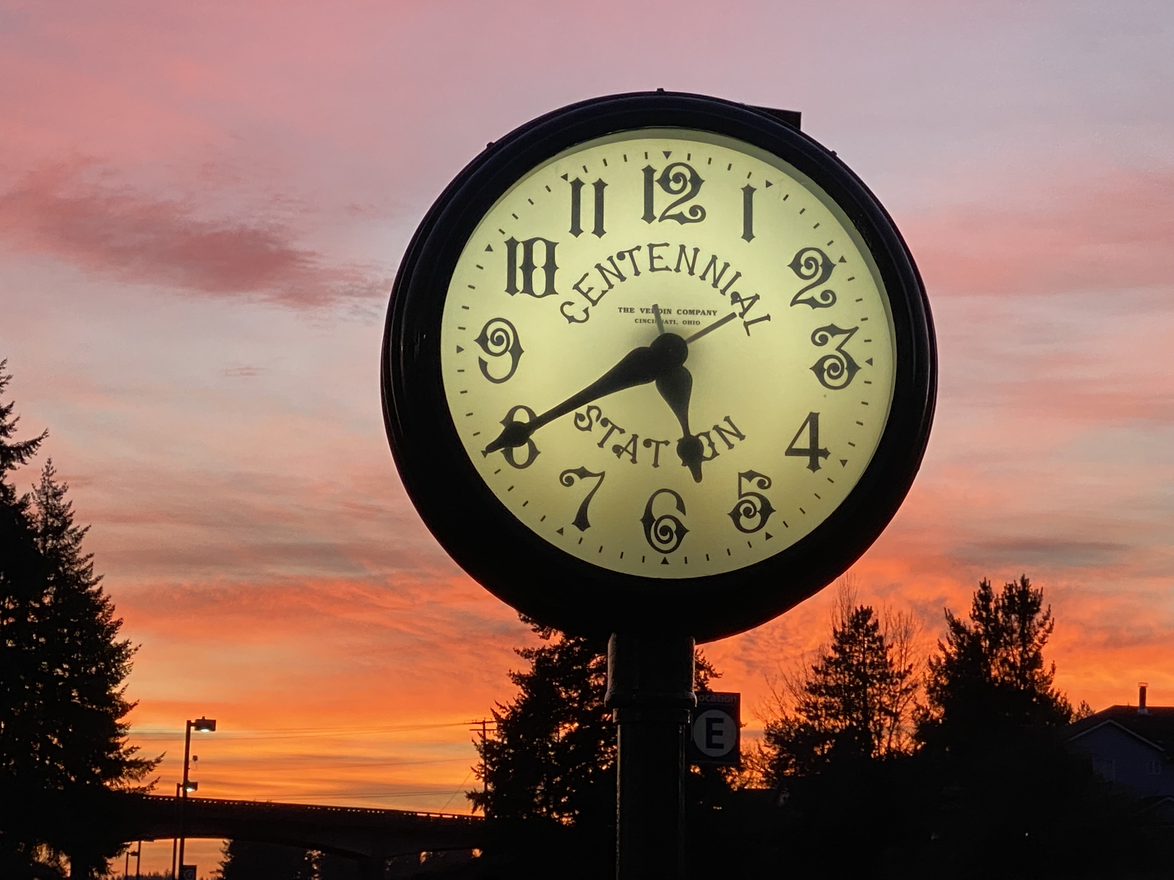
Talgo Clock
Gift of Talgo Co., Manufacturer of Talgo Trainsets

Slide 15
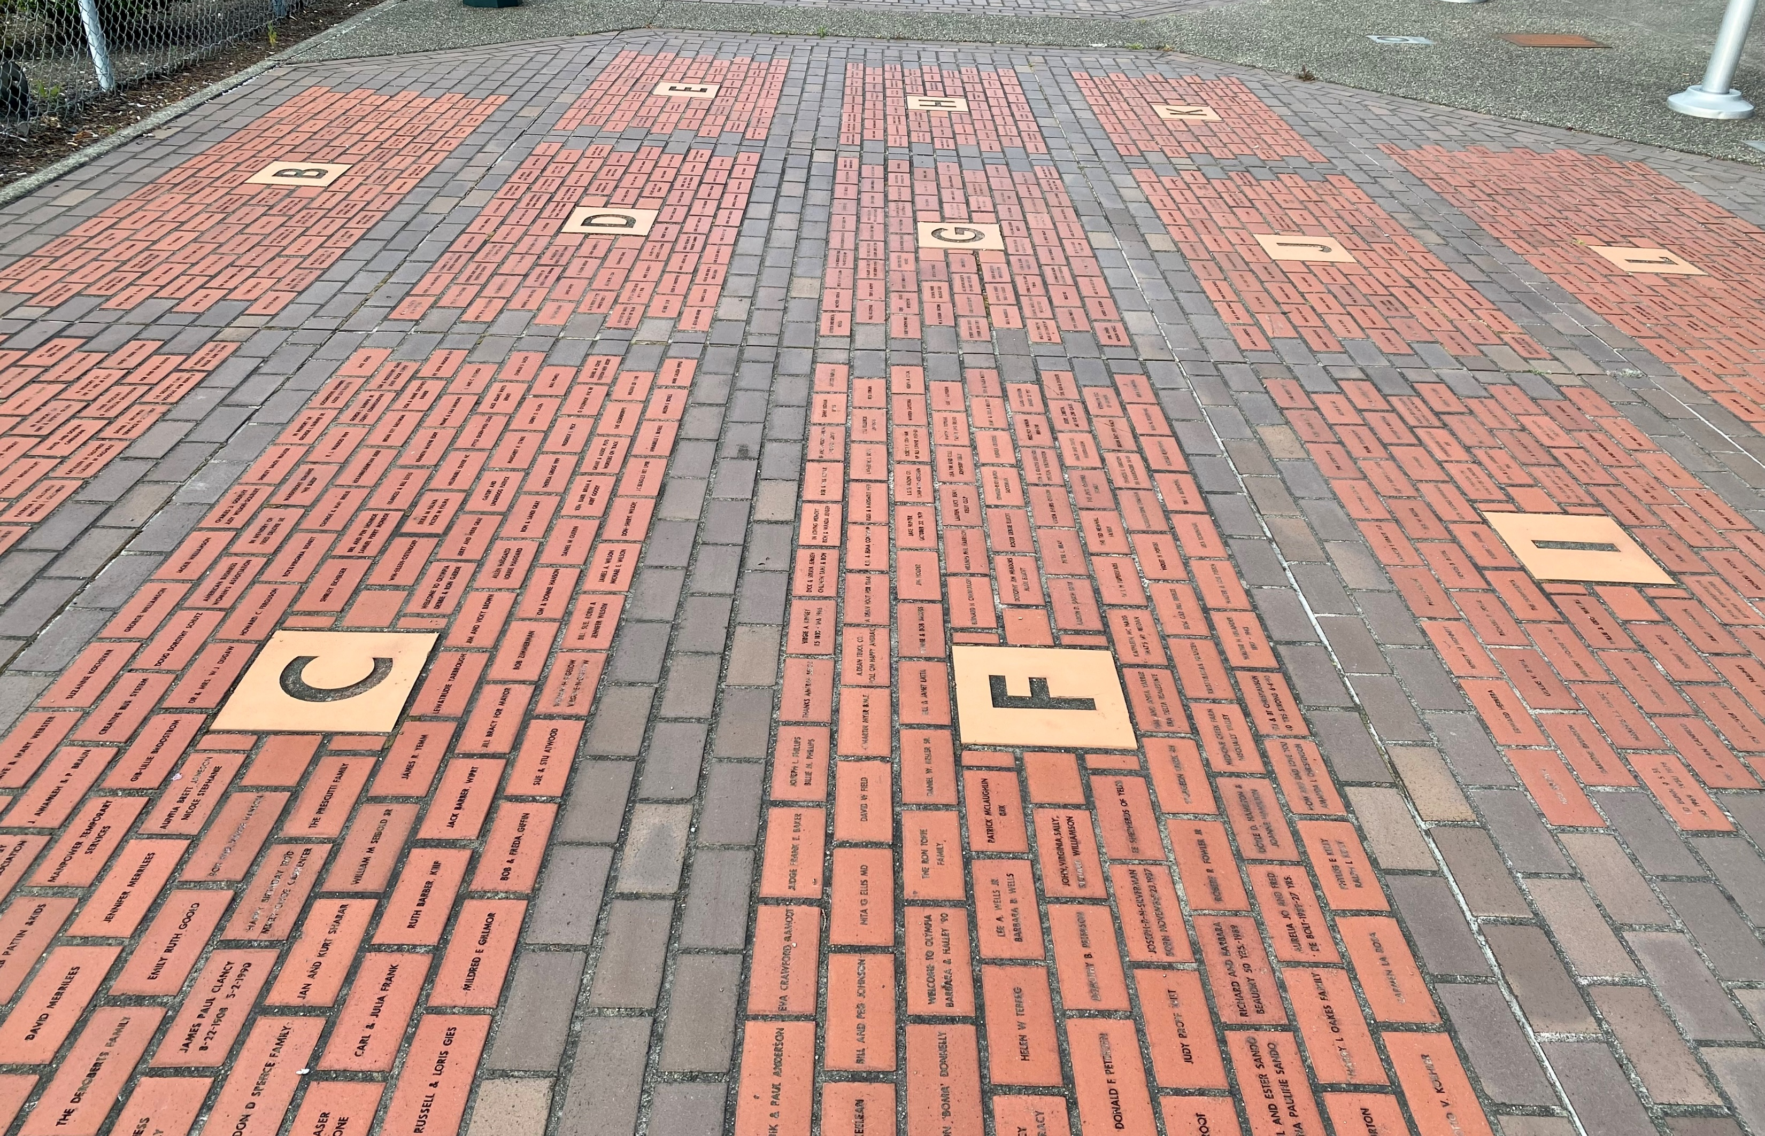
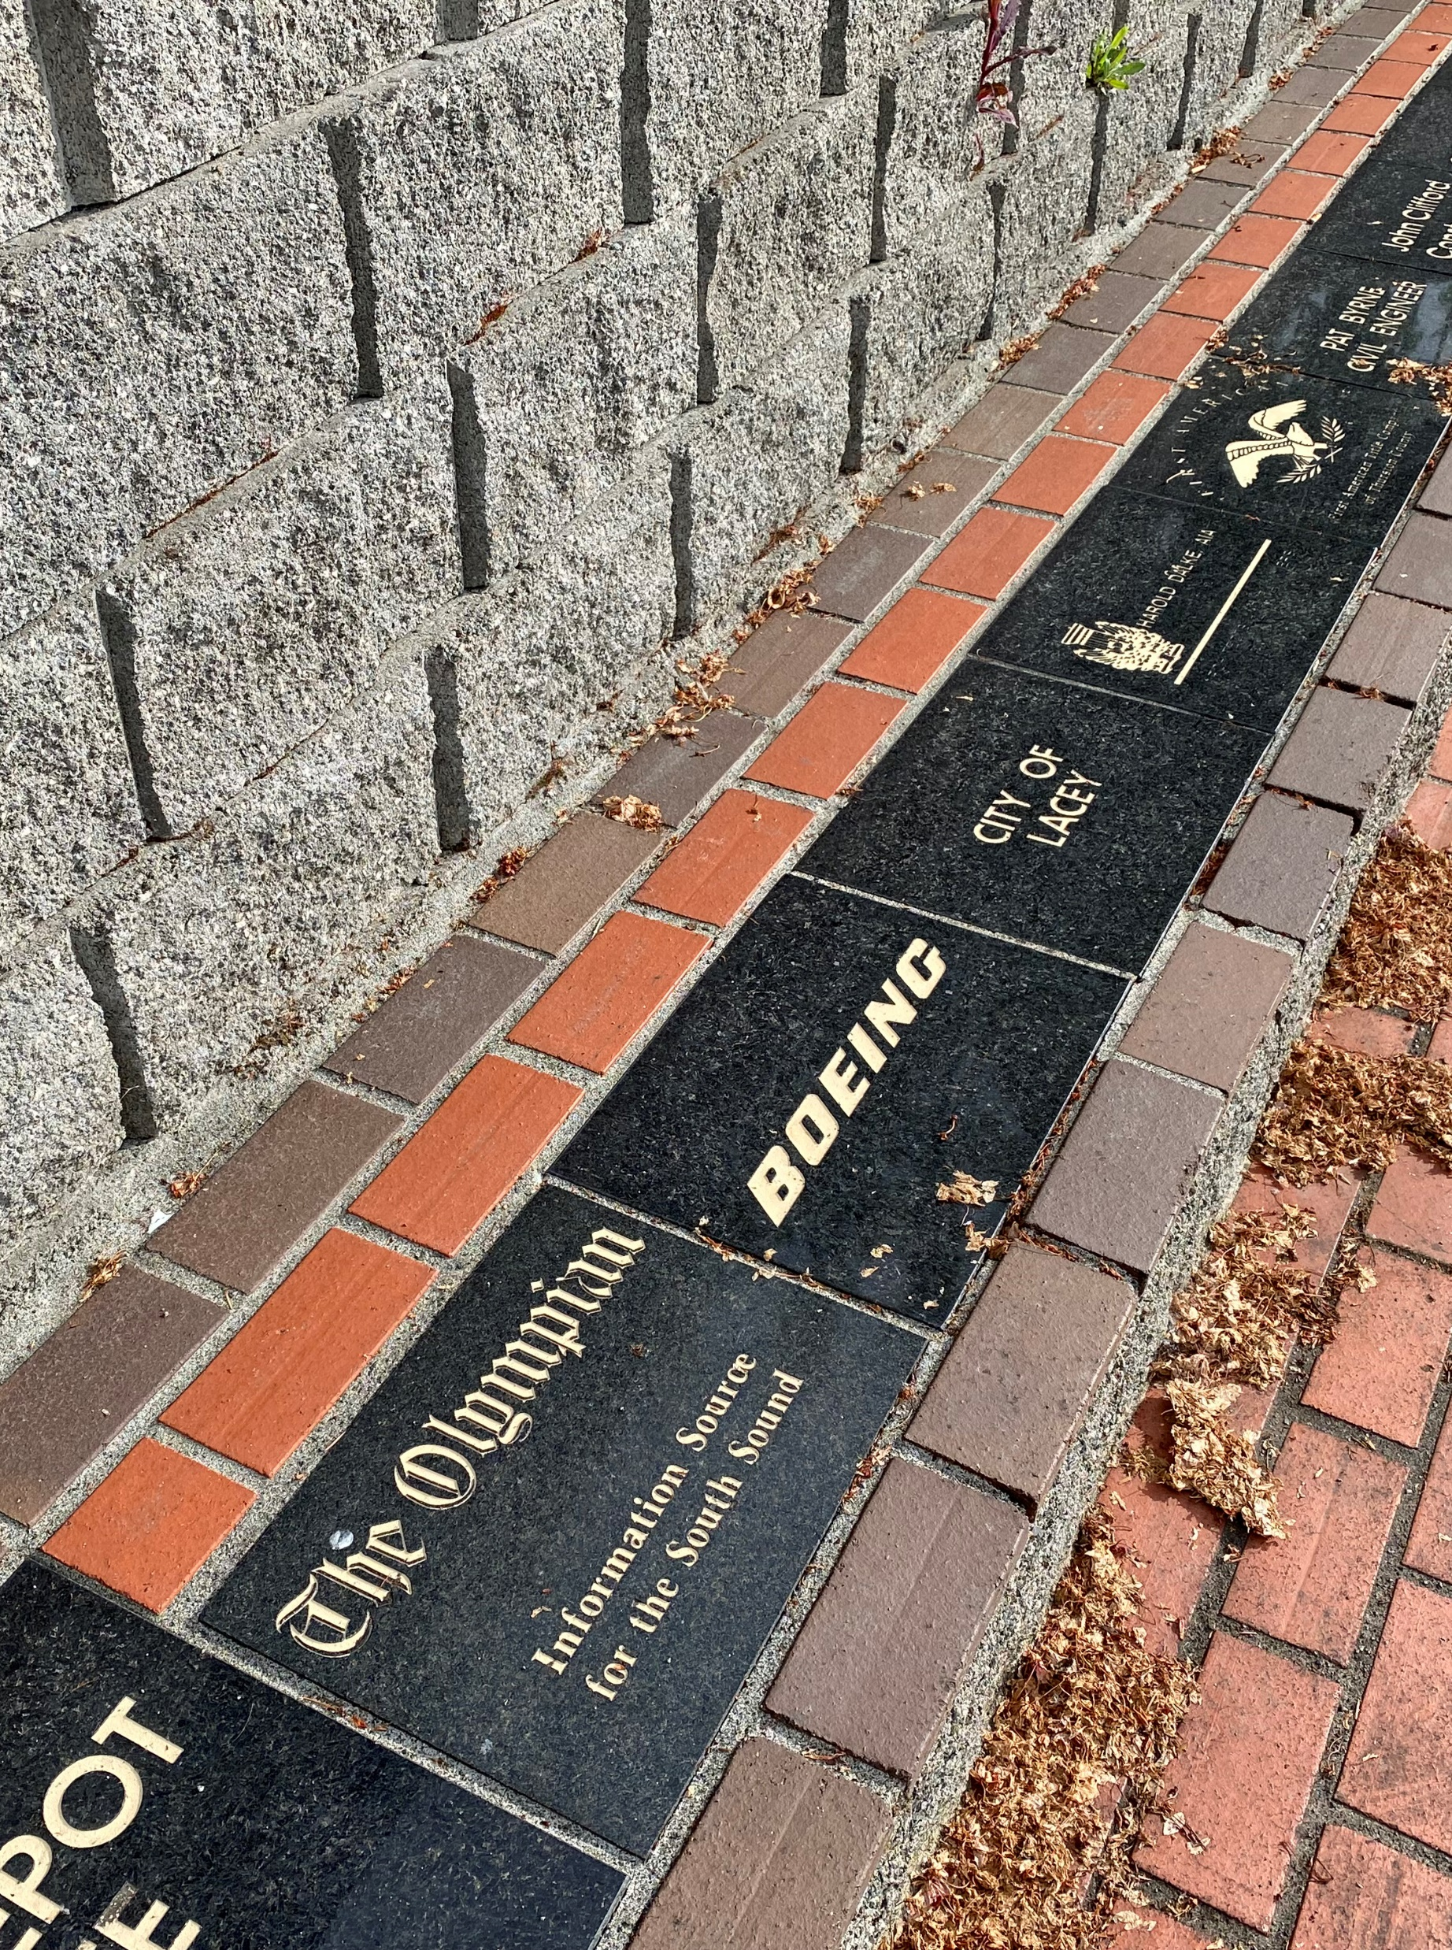
Donors

Slide 16
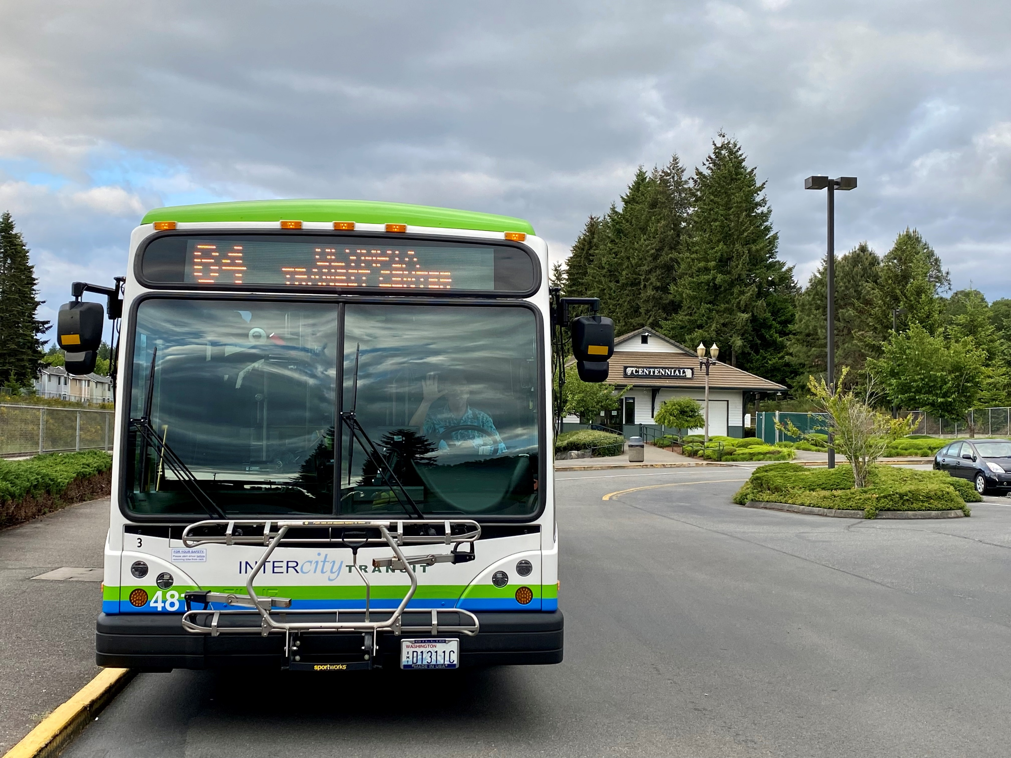
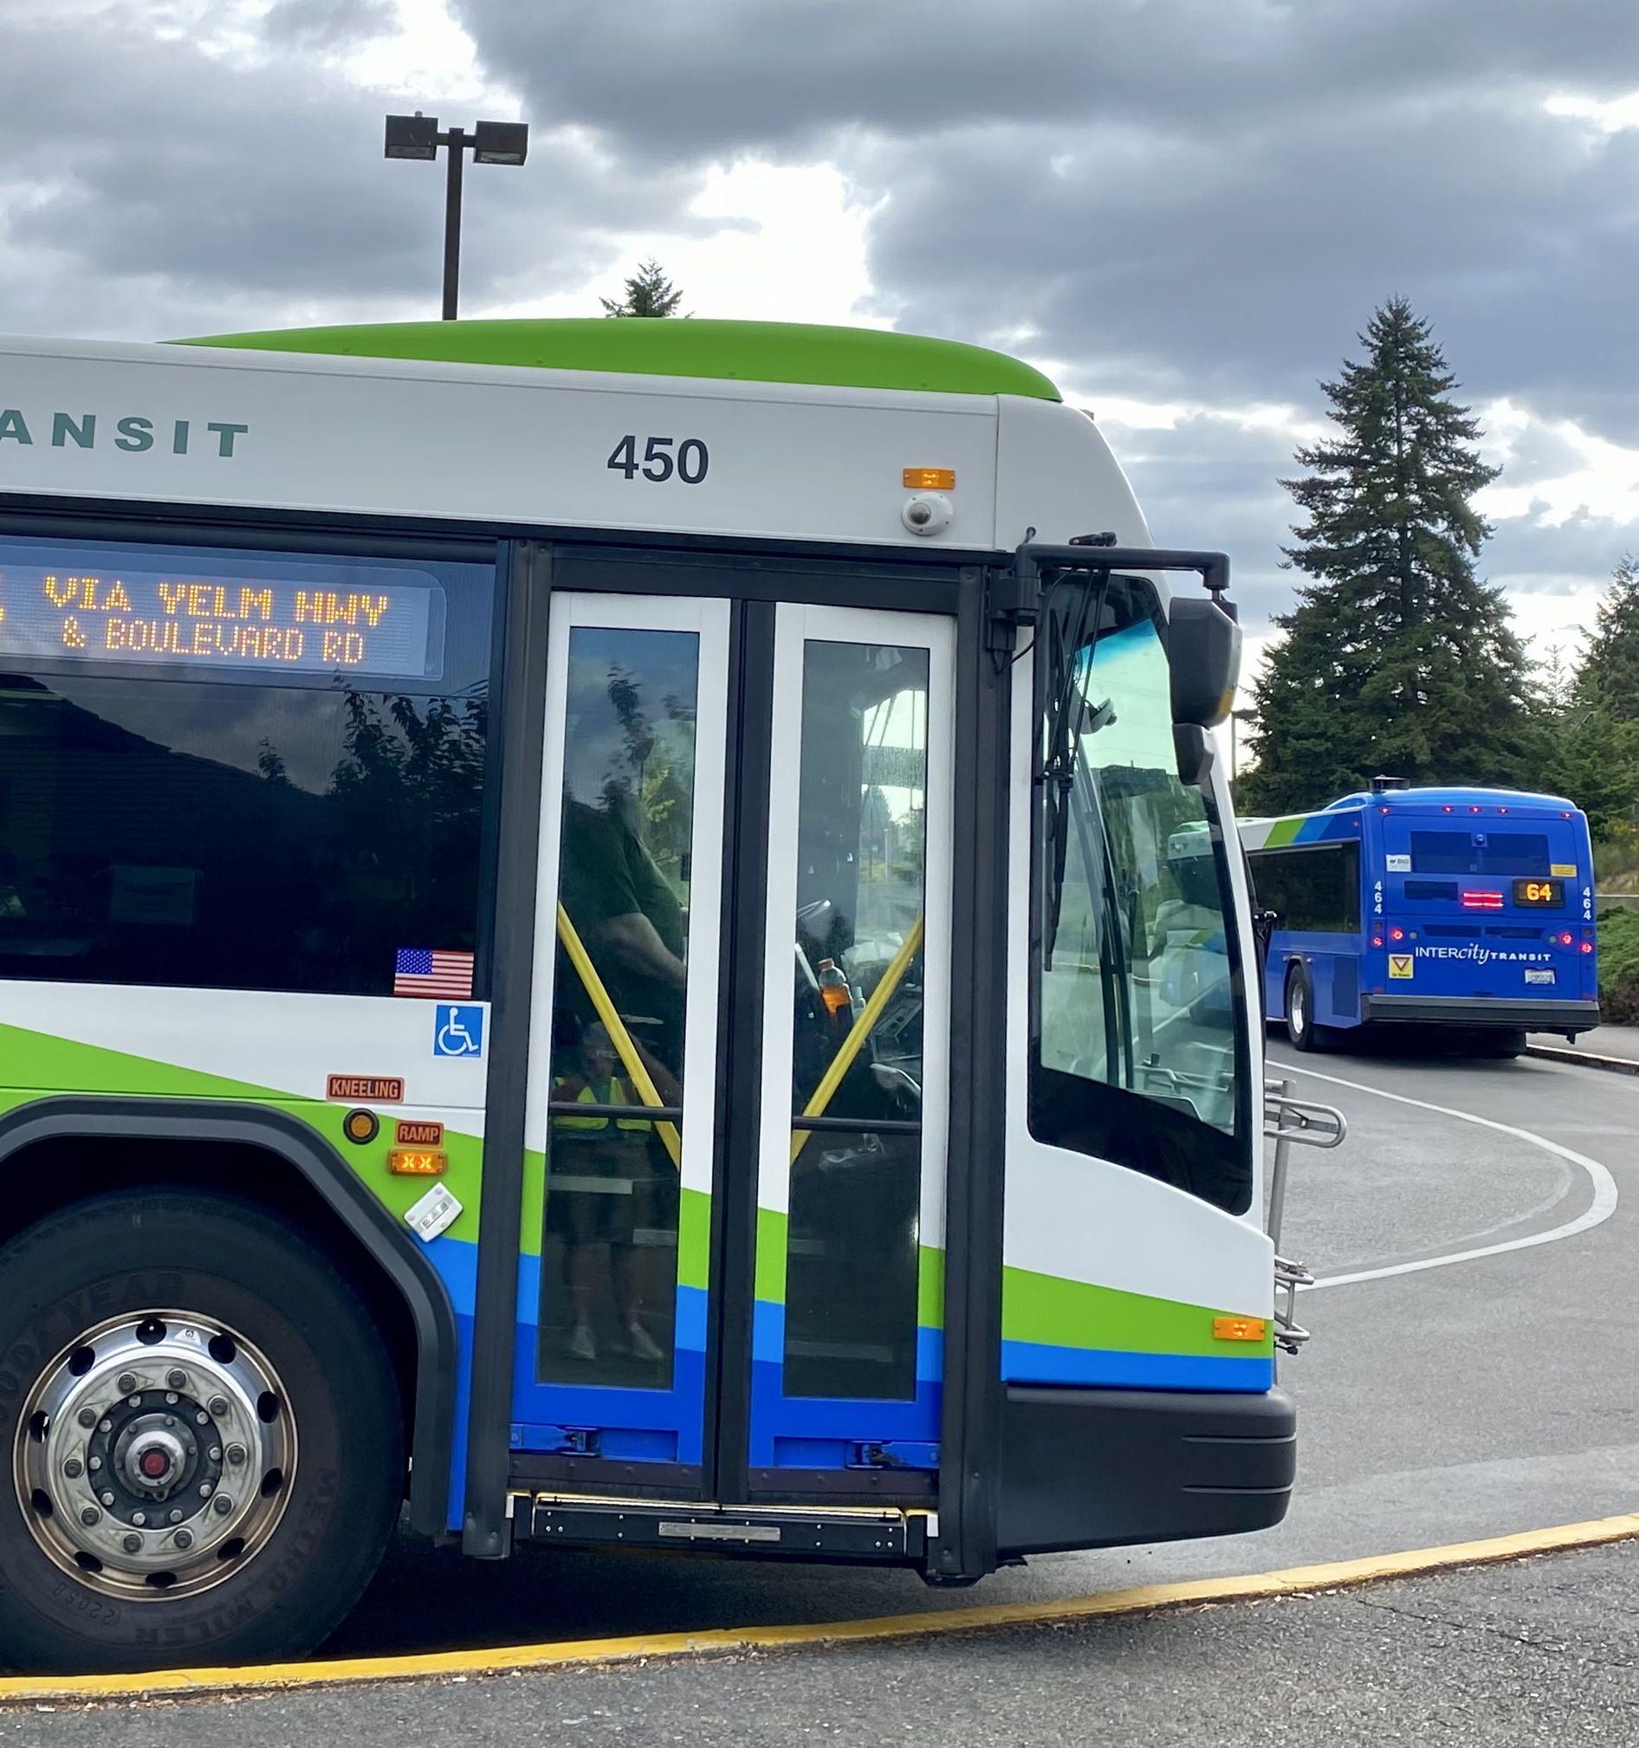
InterCity
Transit

Slide 17
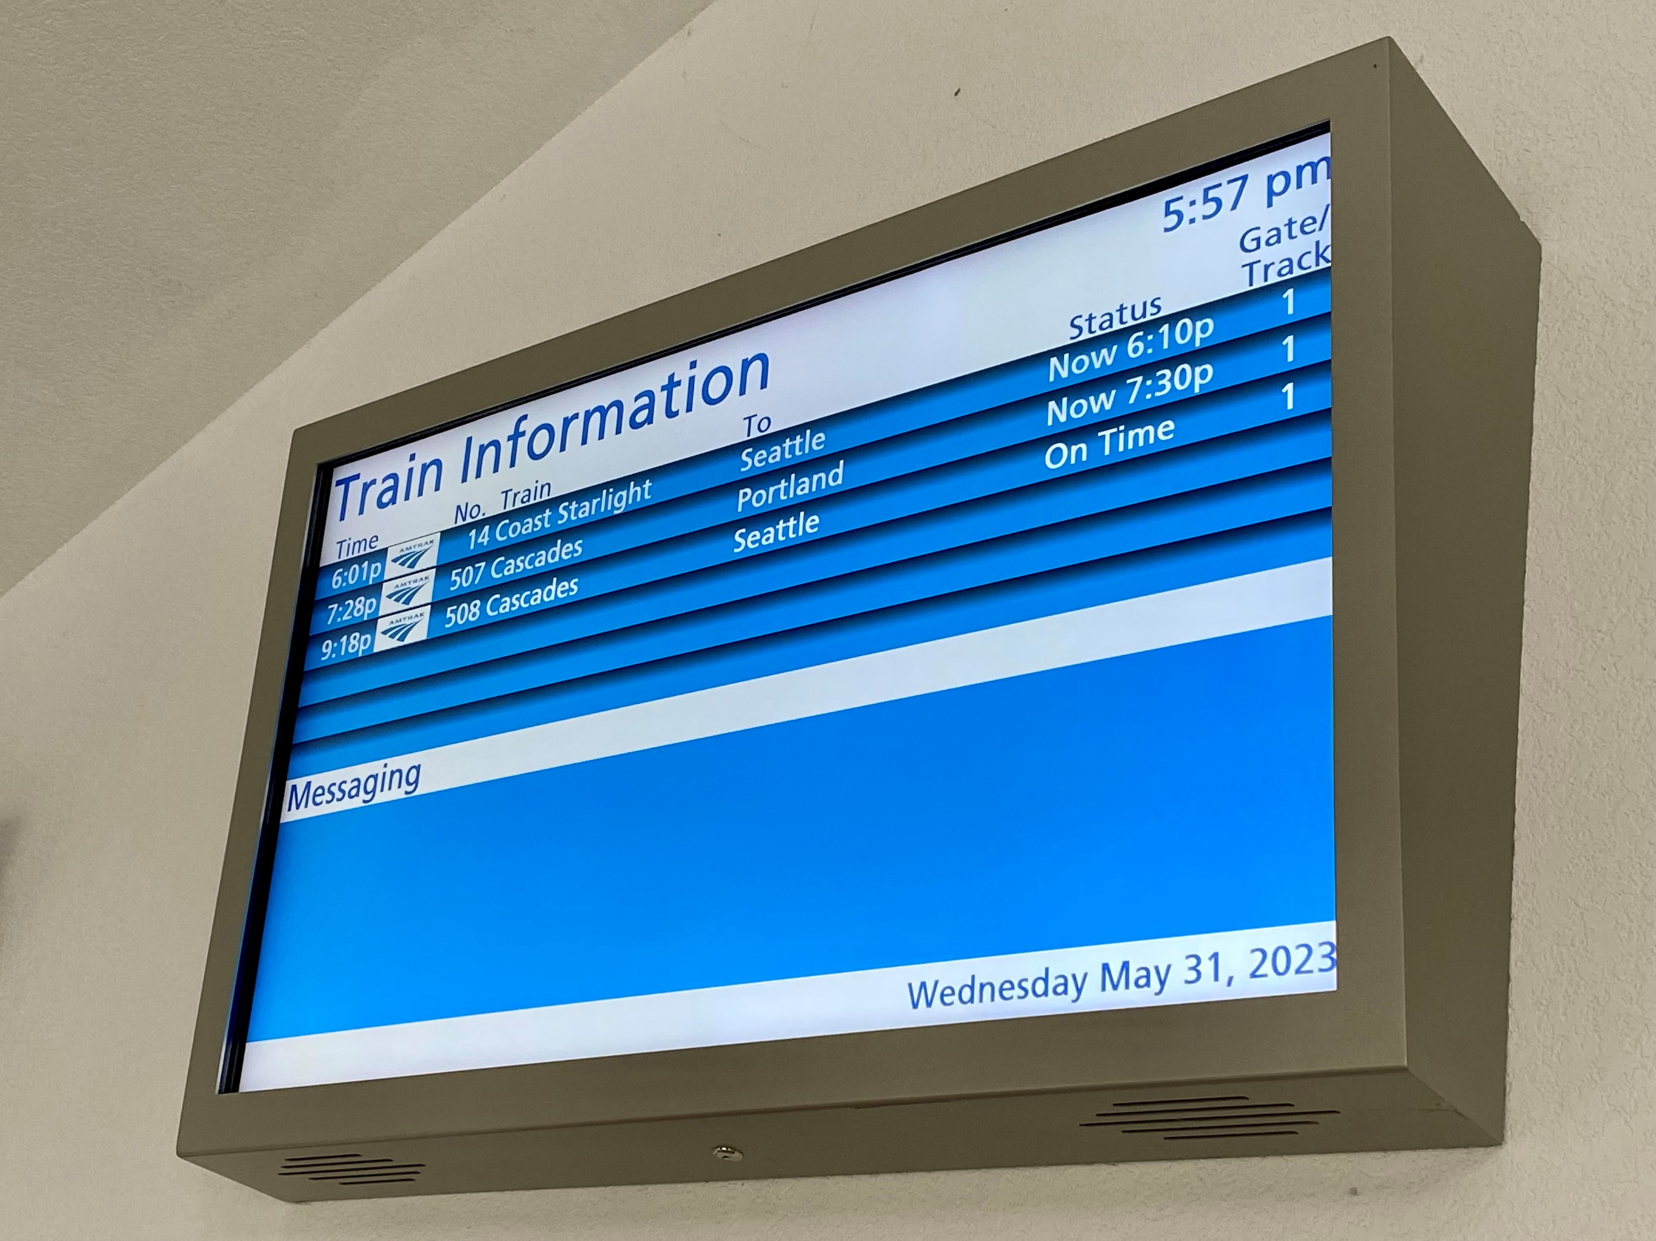
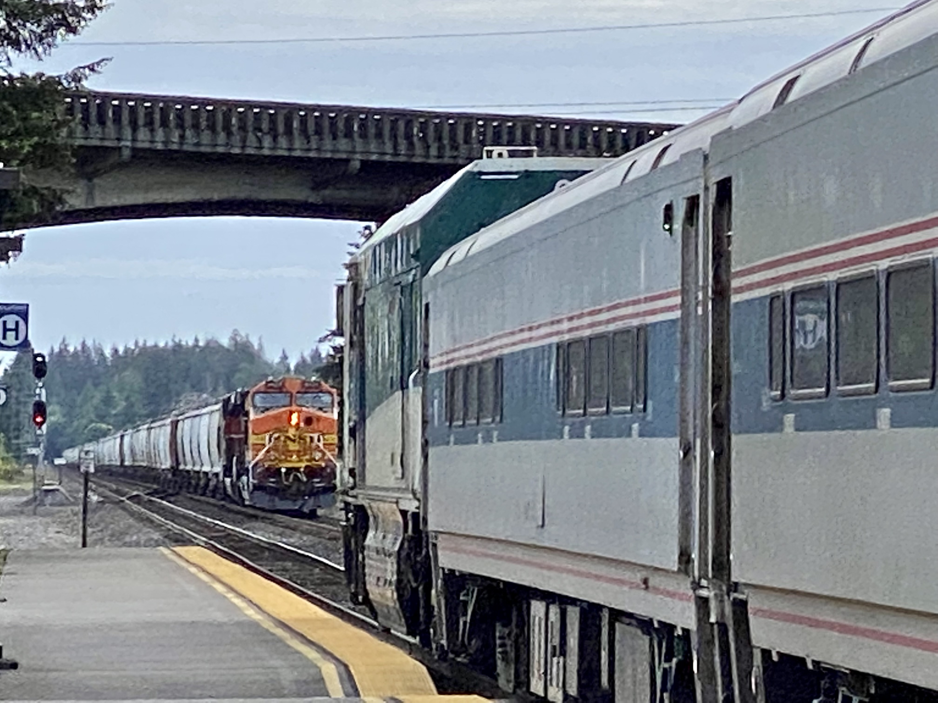
Amtrak
Public Info
Display

Slide 18
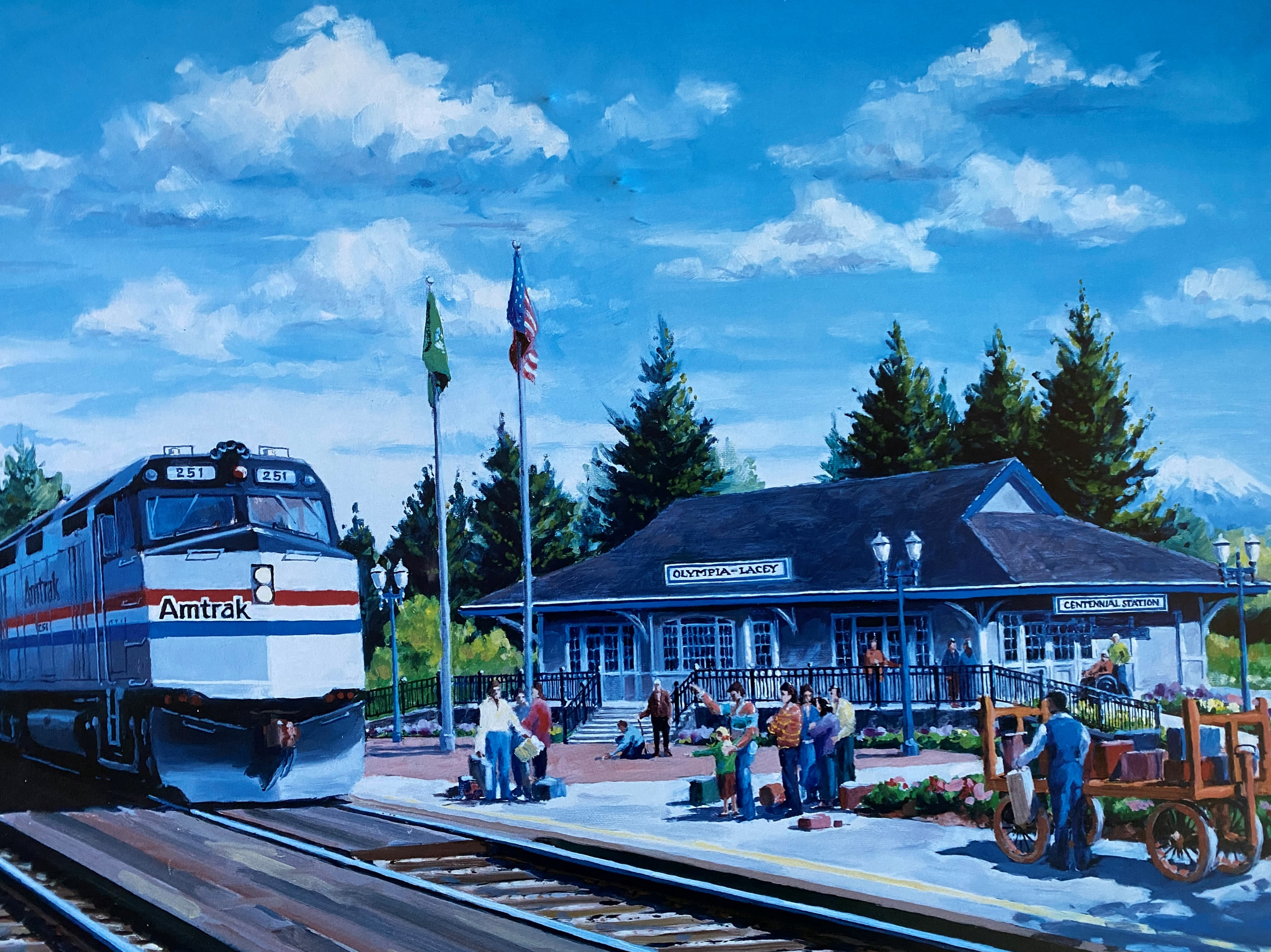

Slide 19
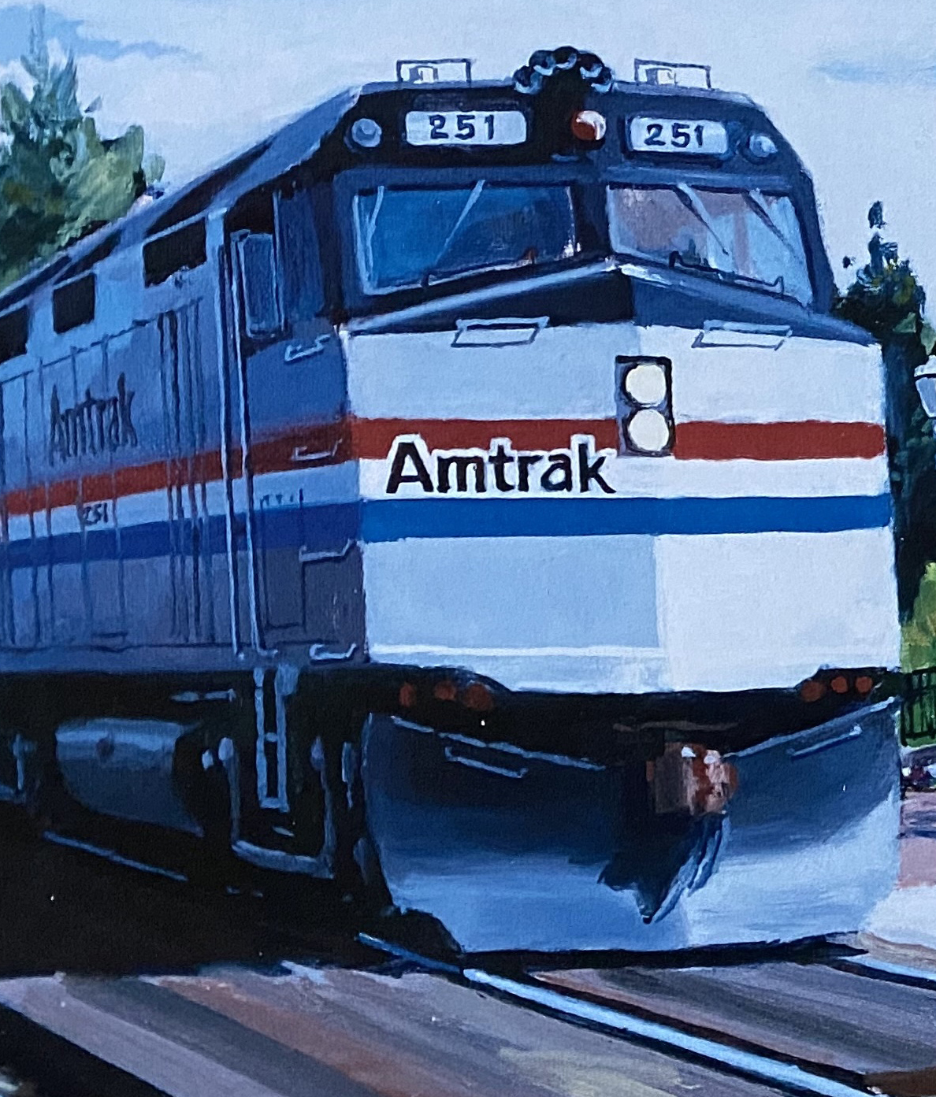
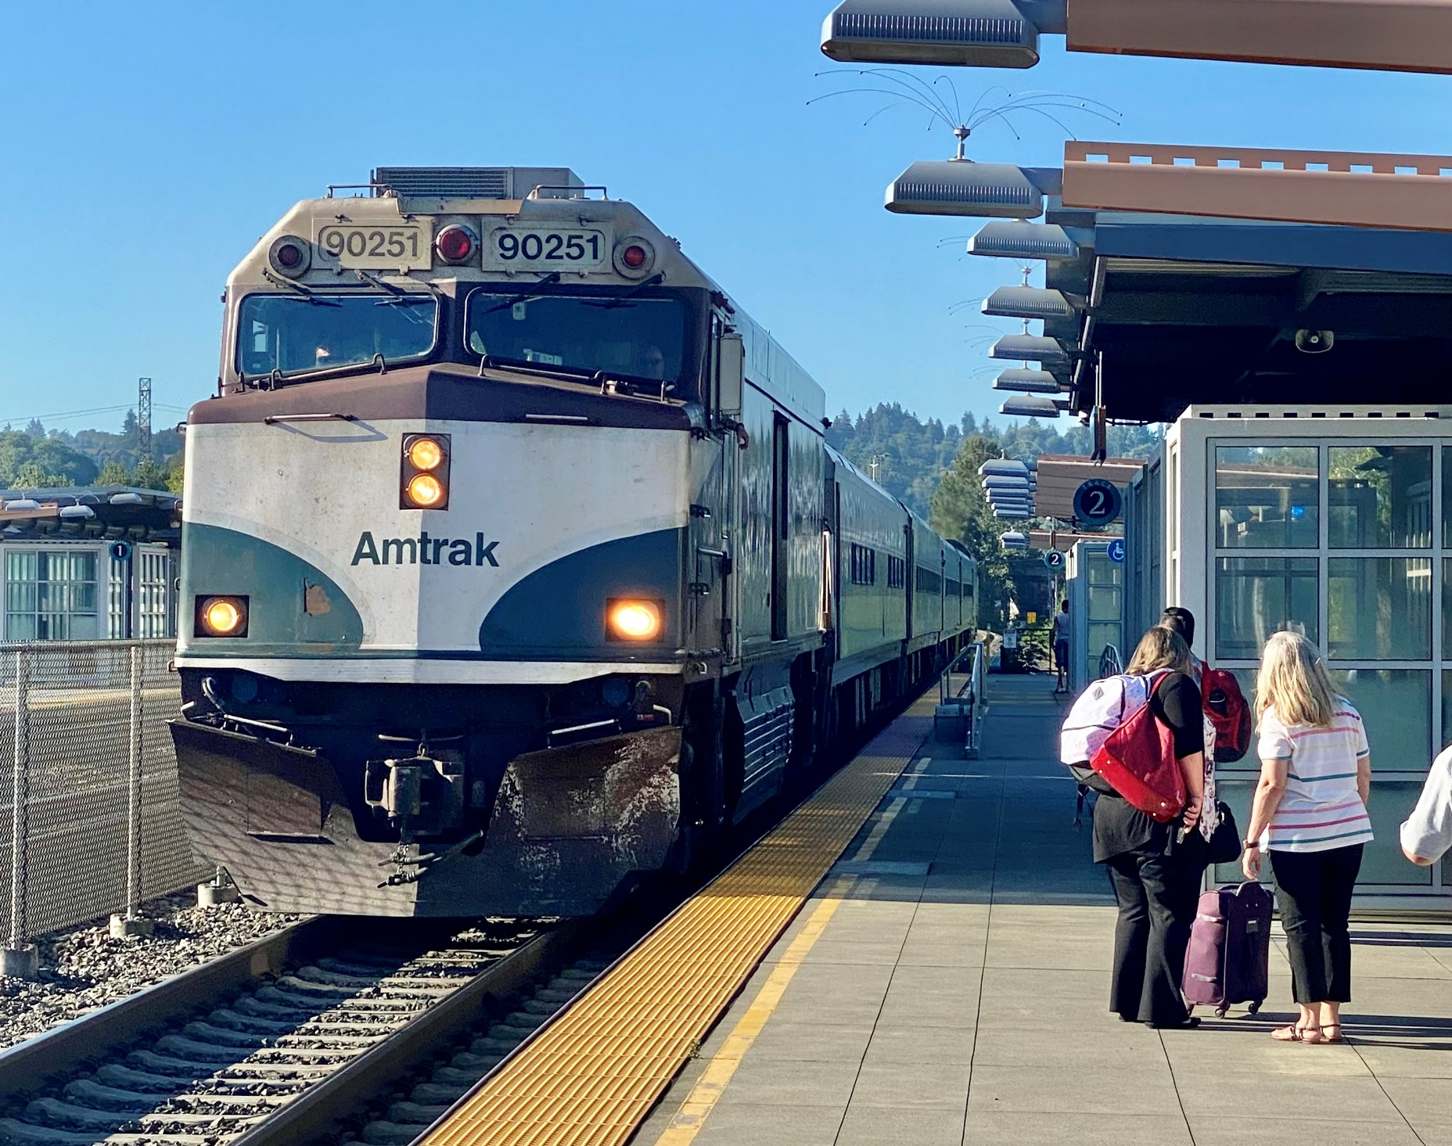
Engine 251 (Amtrak Coast Starlight 1990s) and CAB 90251 (Amtrak Cascades 2026)

Slide 20
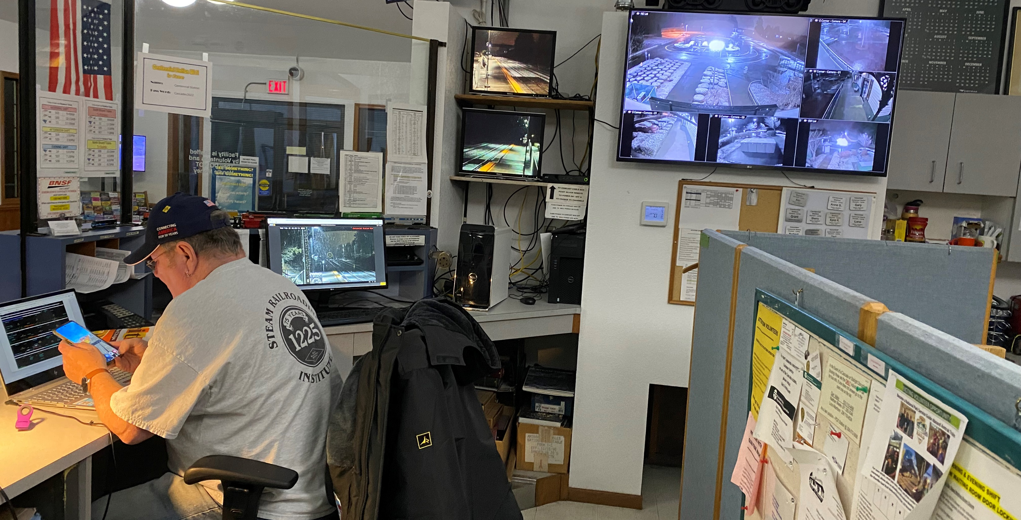
The Volunteers

Slide 21
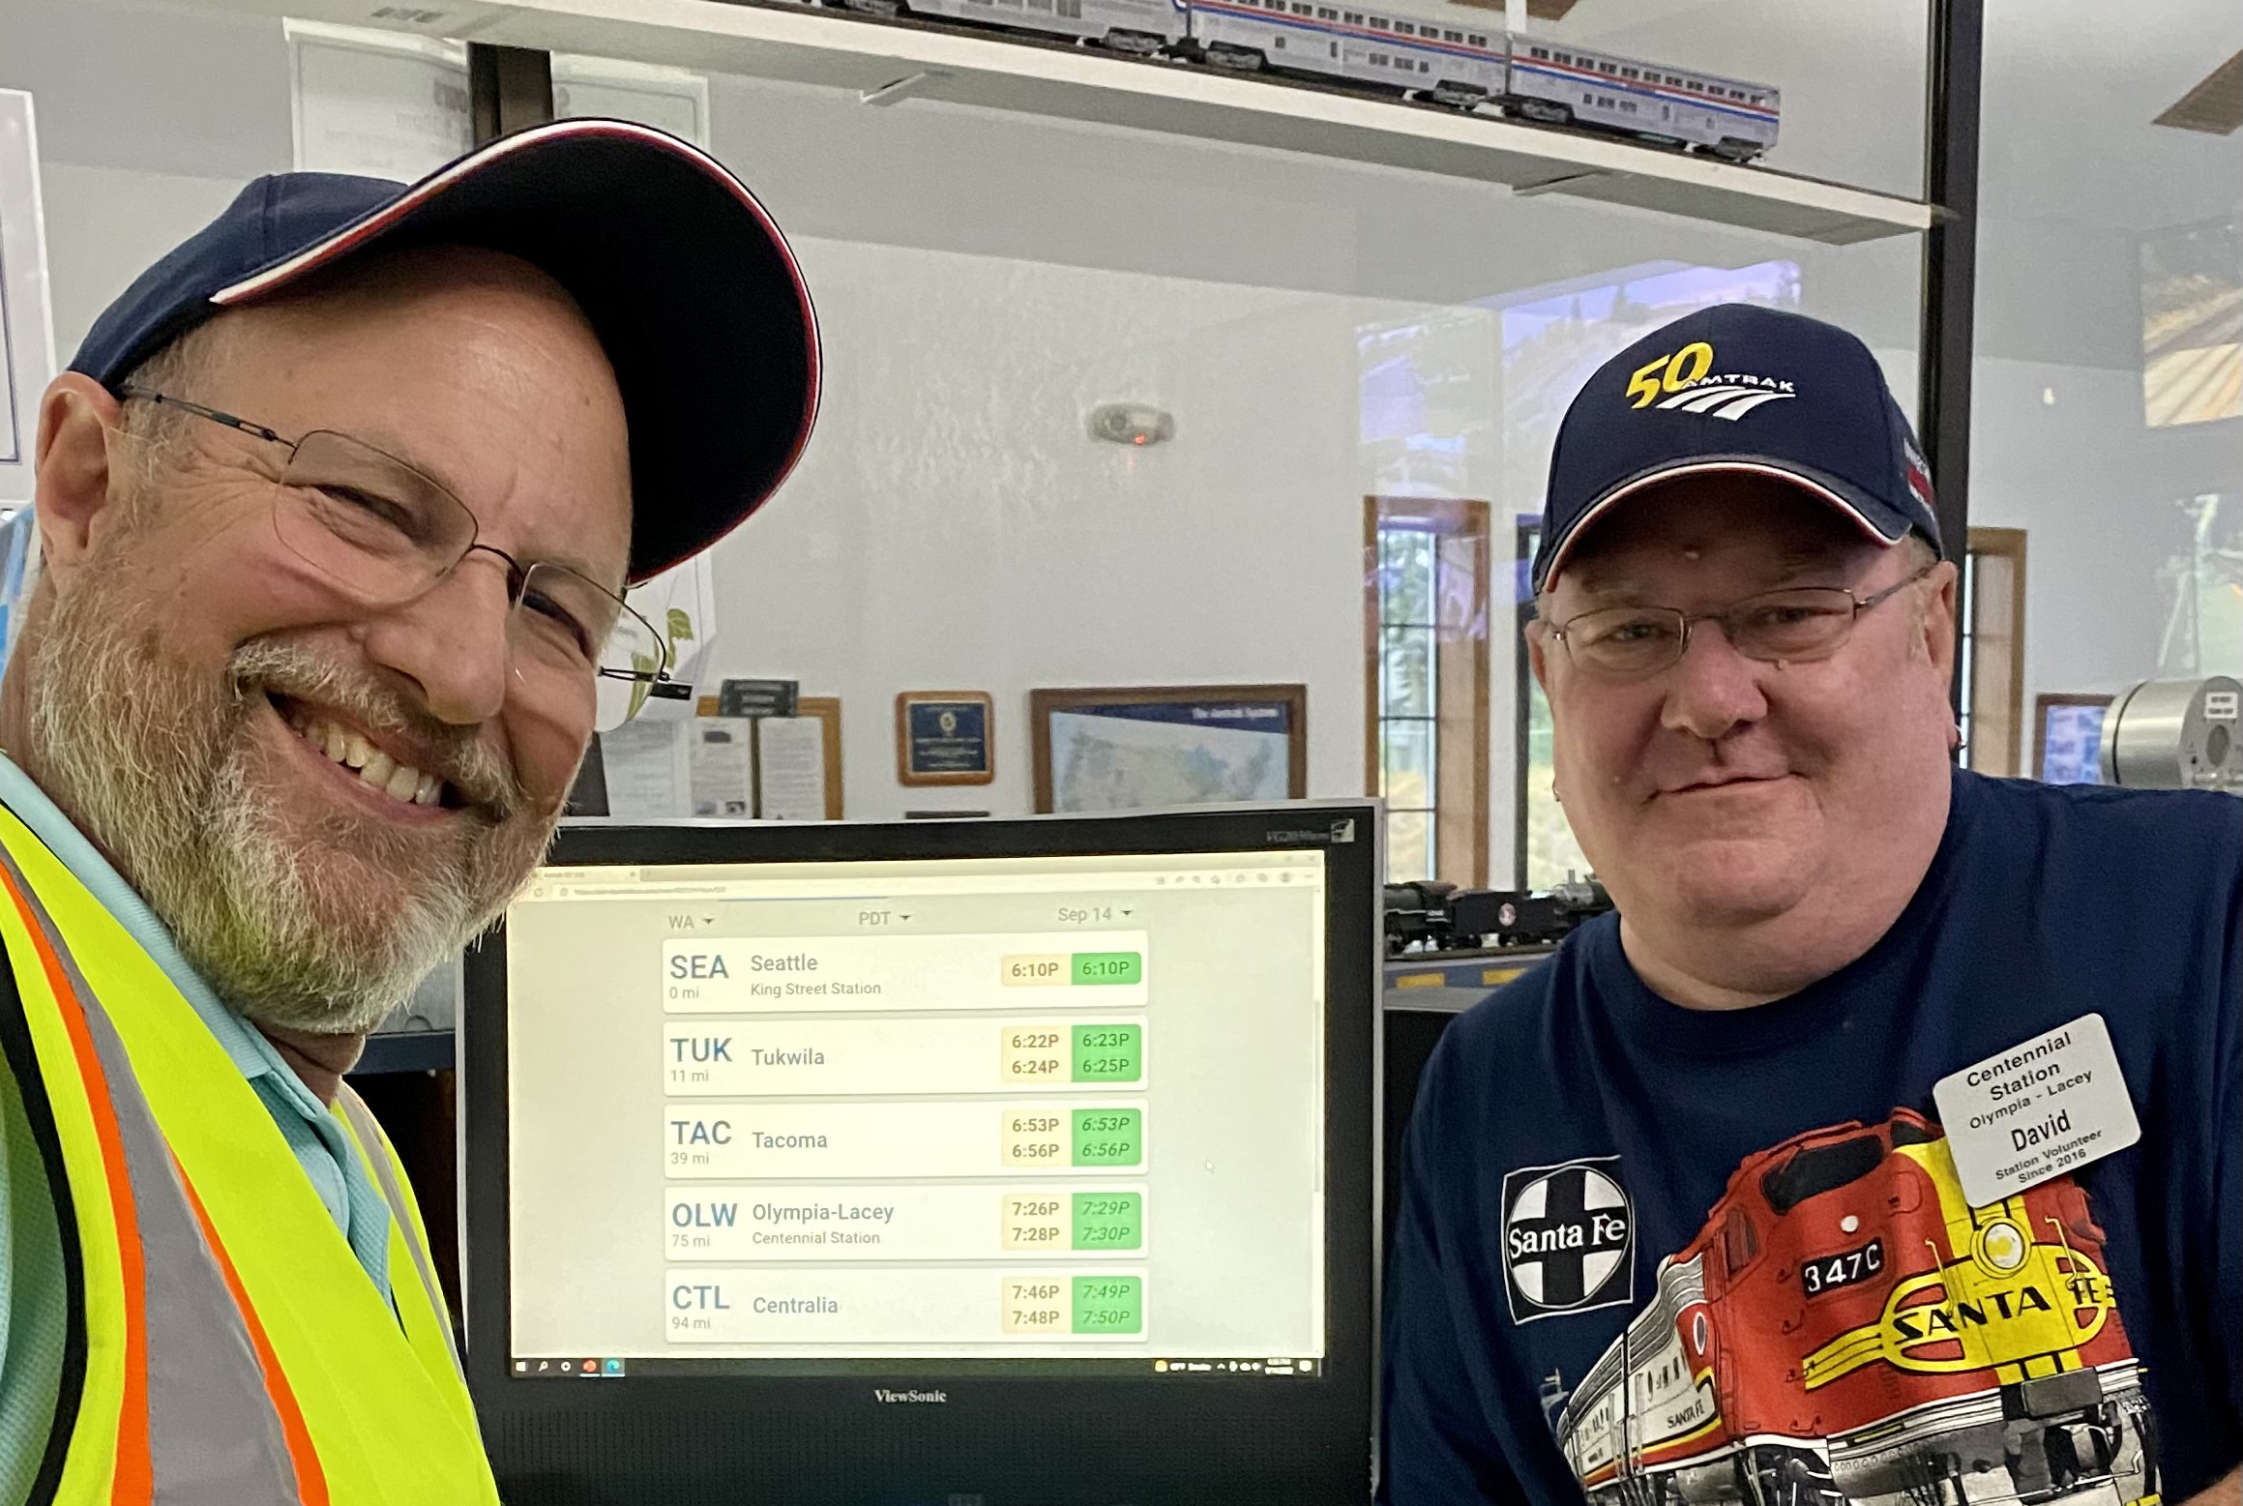
The Volunteers Meet Every Train 24/7

Slide 22
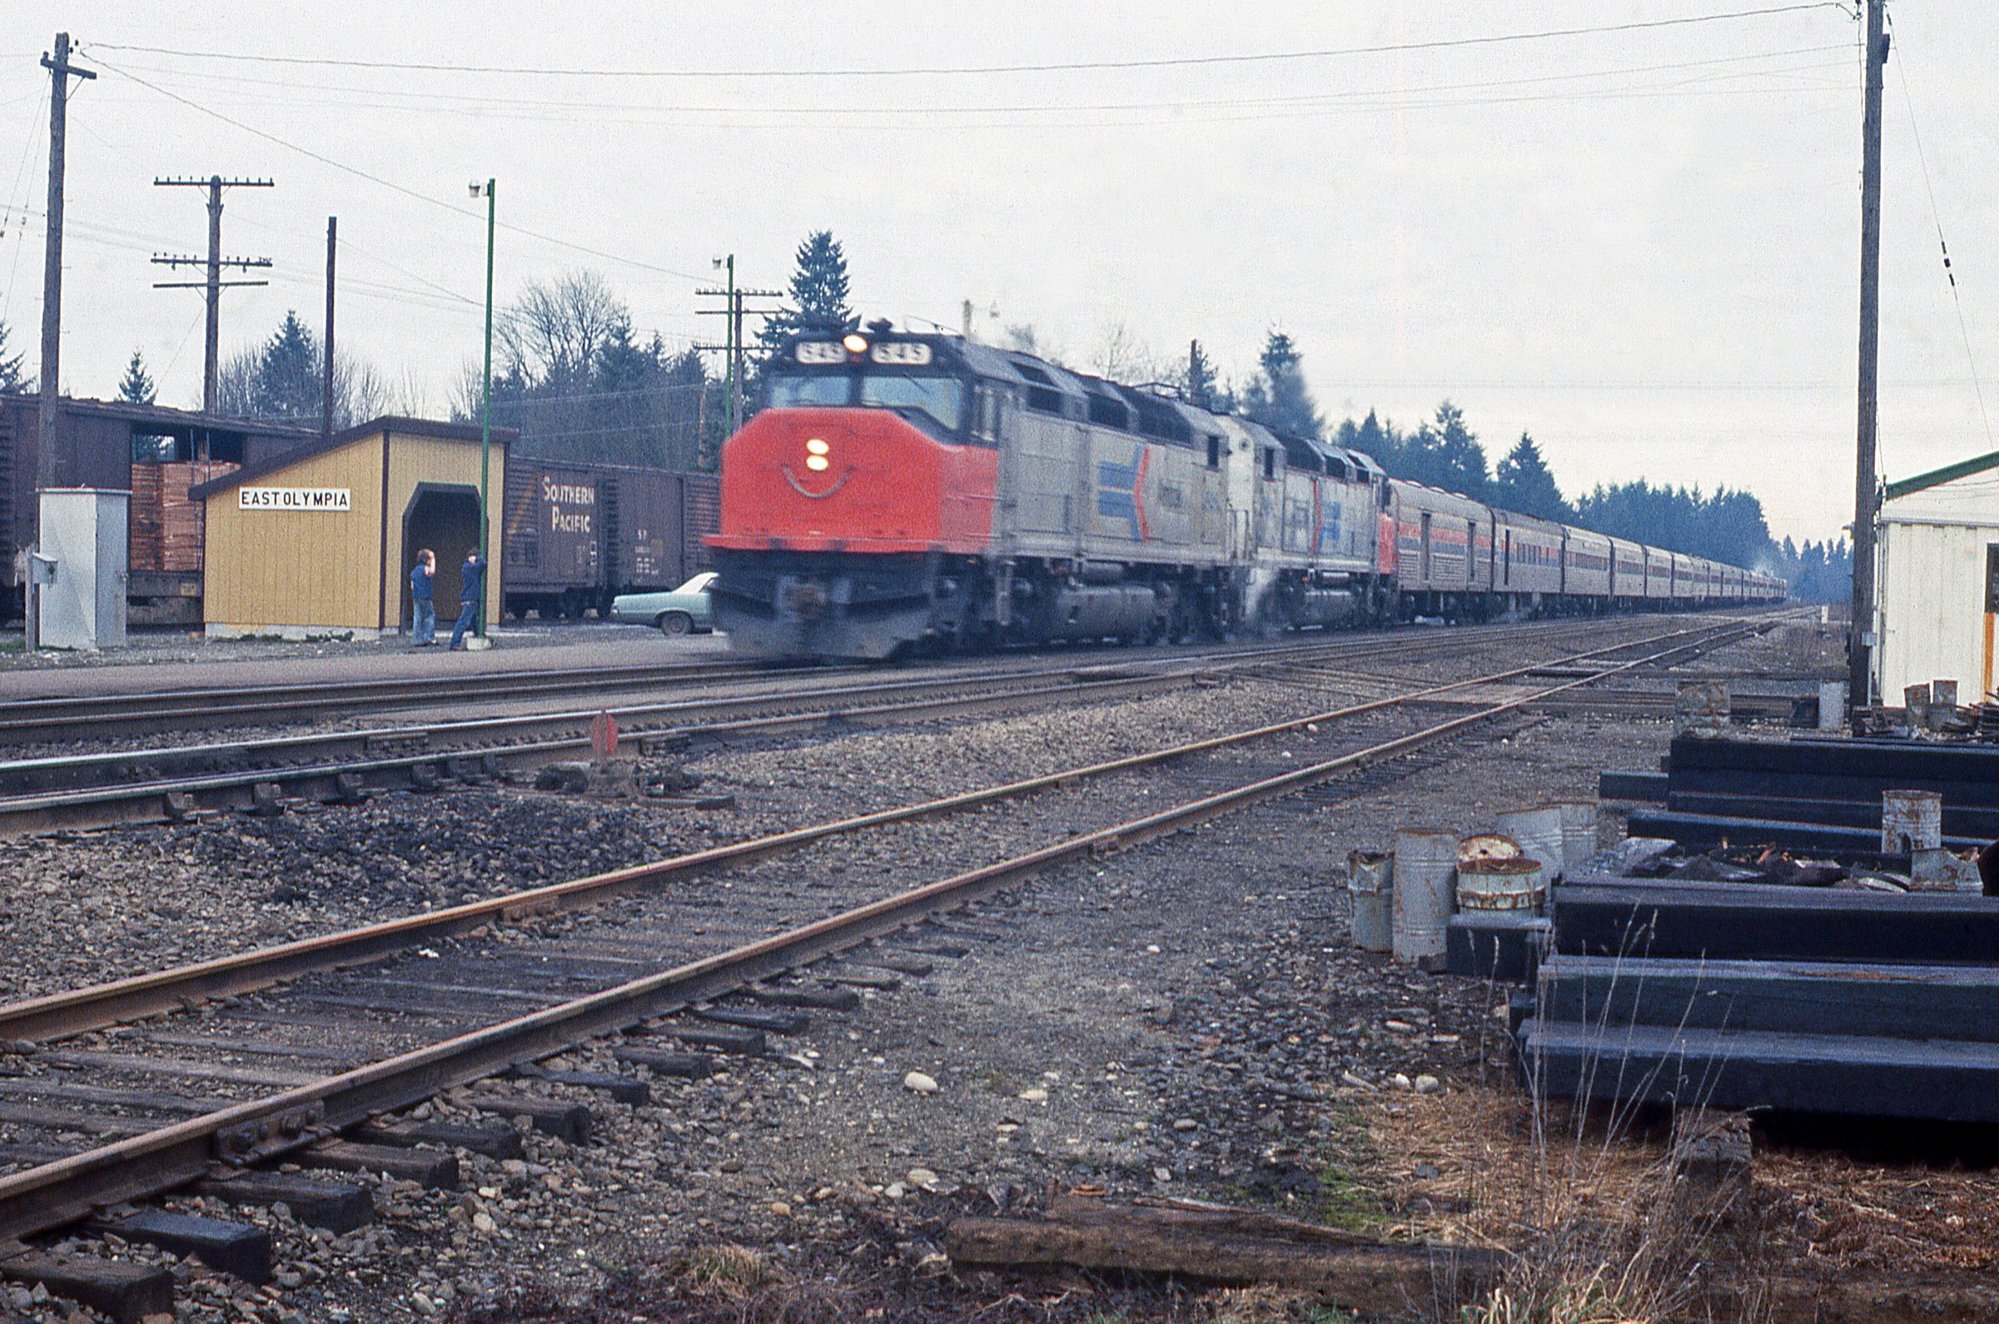
“AmShack:”
The “Station” on
Rich Road that our station replaced.
Photo taken in 1980 by Walt Vitous. Courtesy of Paul Vitous.

Slide 23
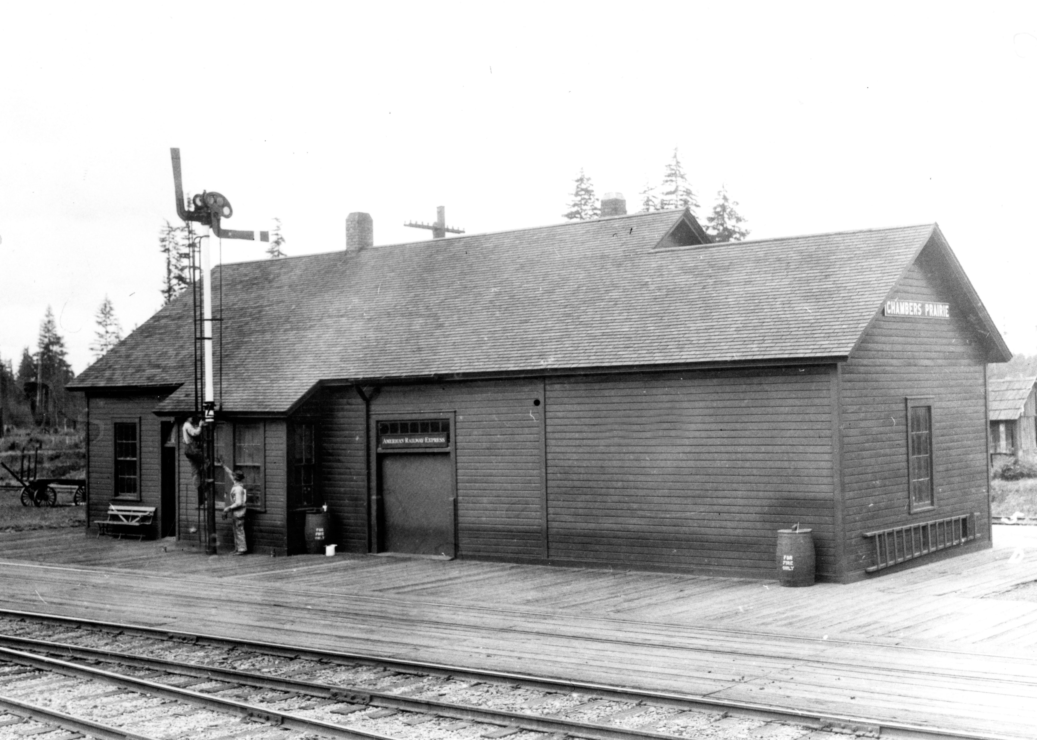
Chambers Prairie/
Union Pacific
Later named
“East Olympia”
May 22, 1928
James Fisher
(Courtesy NP Historical Assn.)
Original East Olympia (Rich Road) predecessor to “AmShack” and our station.

Slide 24
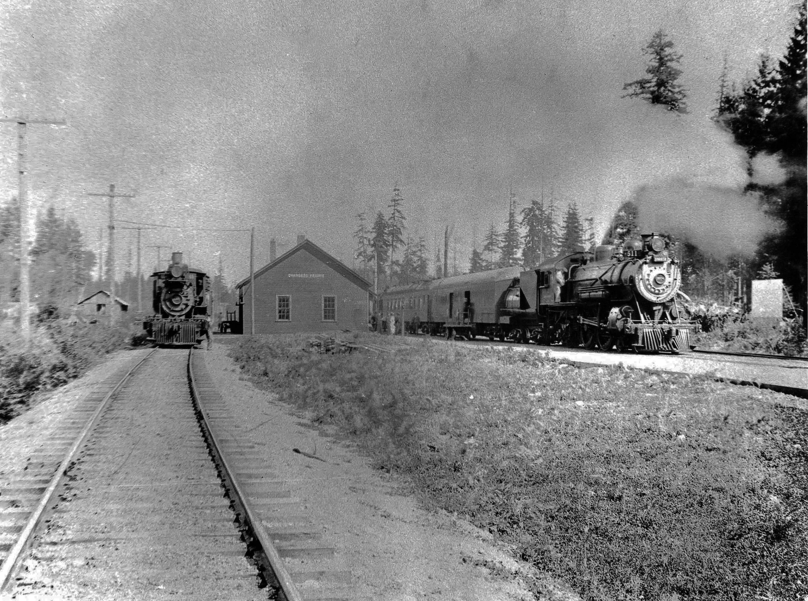
Chambers Prairie
(Courtesy Jim Hannum, Olympia. Lacey Historical Museum)

Slide 25
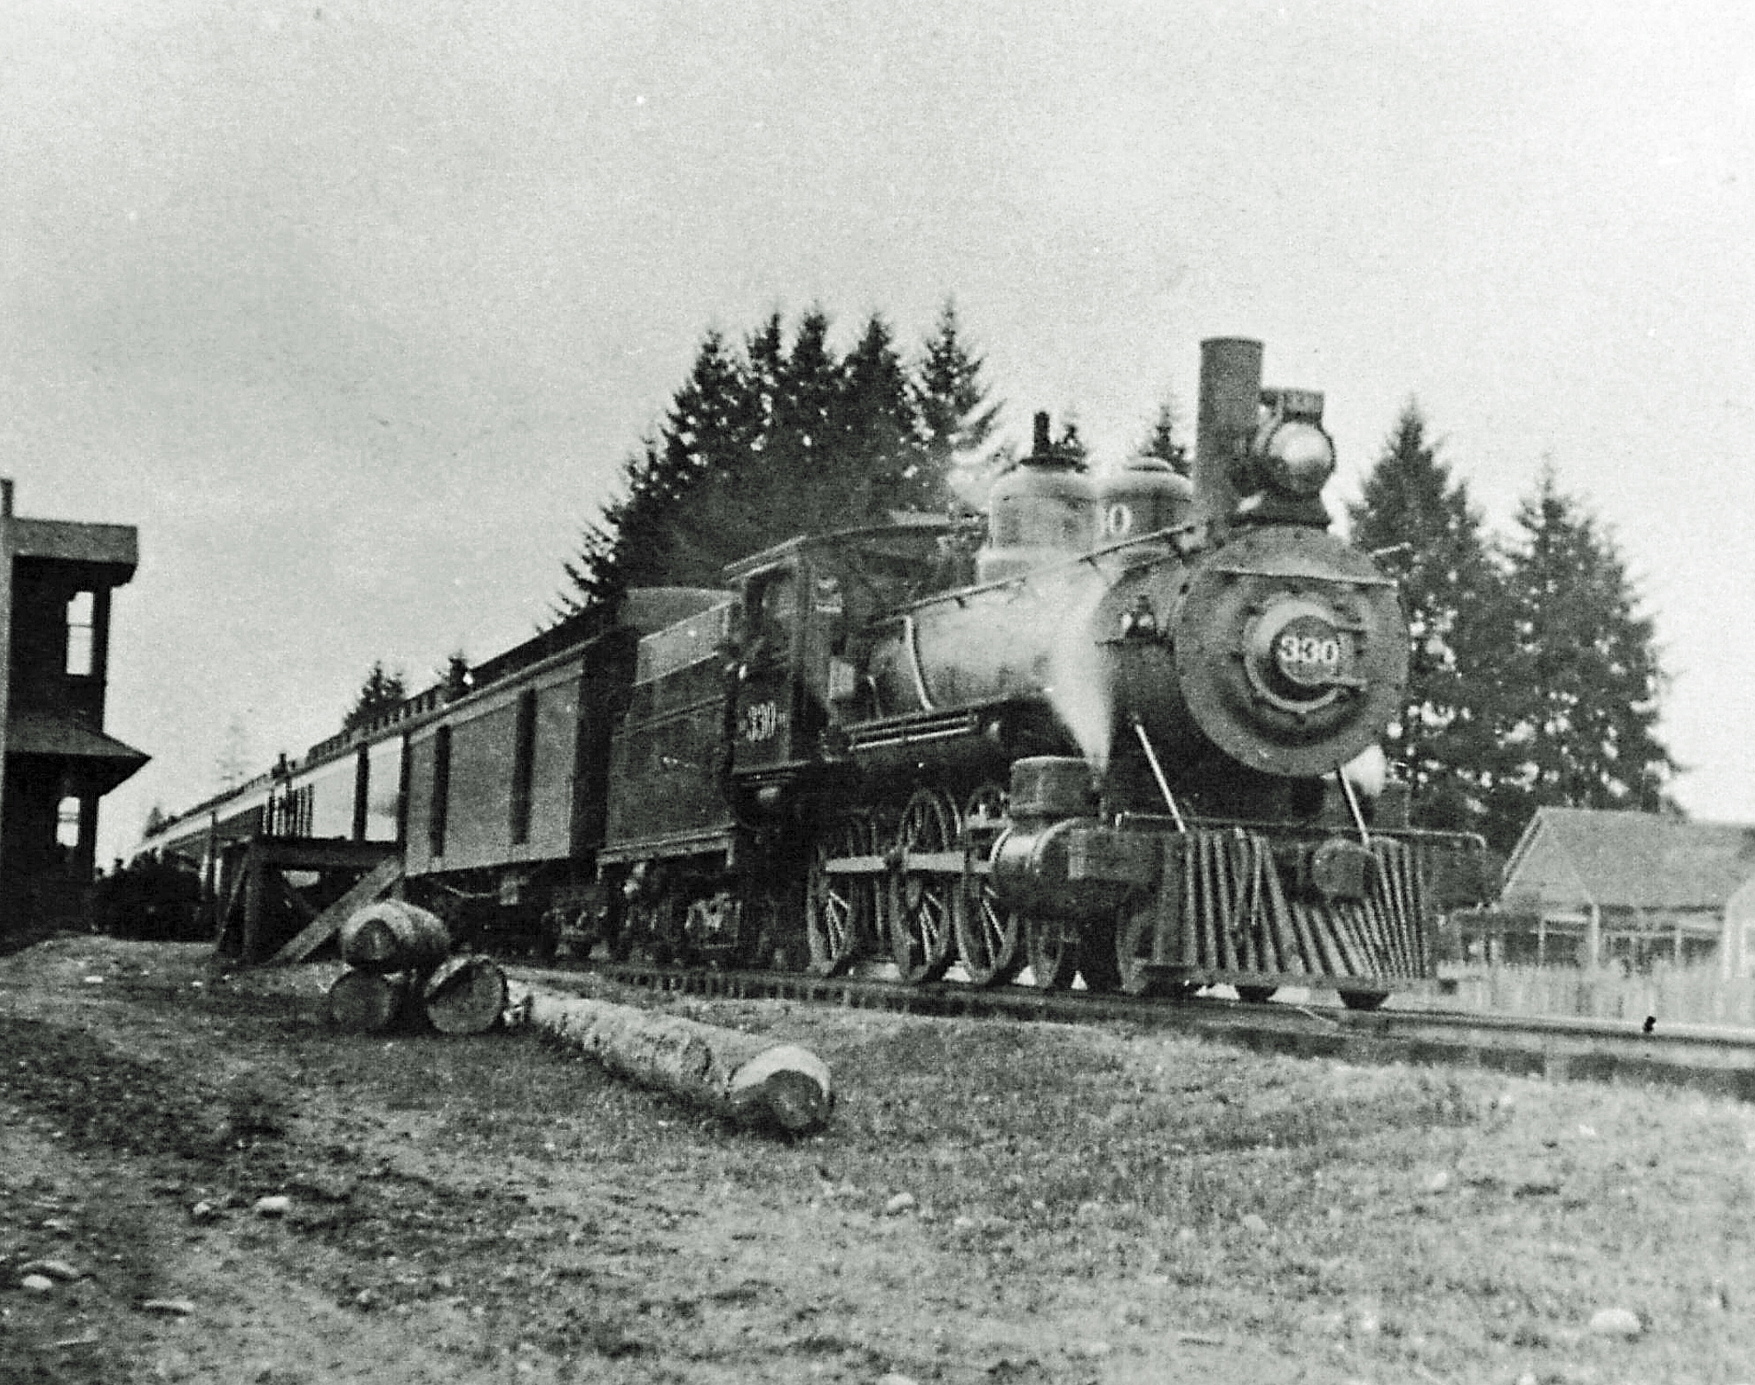
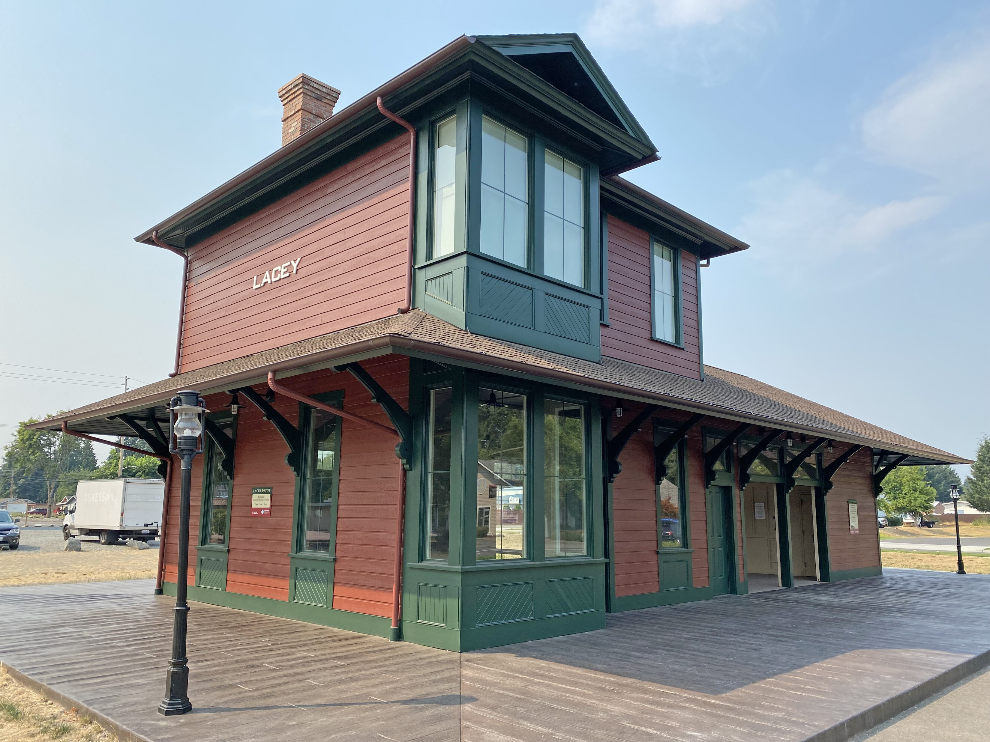
Lacey
NP Depot
Passenger train Tacoma-bound from Lacey Northern Pacific Station in 1912. Photo from the Harold Meir Collection, Courtesy St. Martin's University Abbey. Special thanks to Father Peter Tynan, University Chaplain and Abbey Monk. Locomotive is a Baldwin 4-6-0 built about 1890.
1912
Replica located downtown today

Slide 26
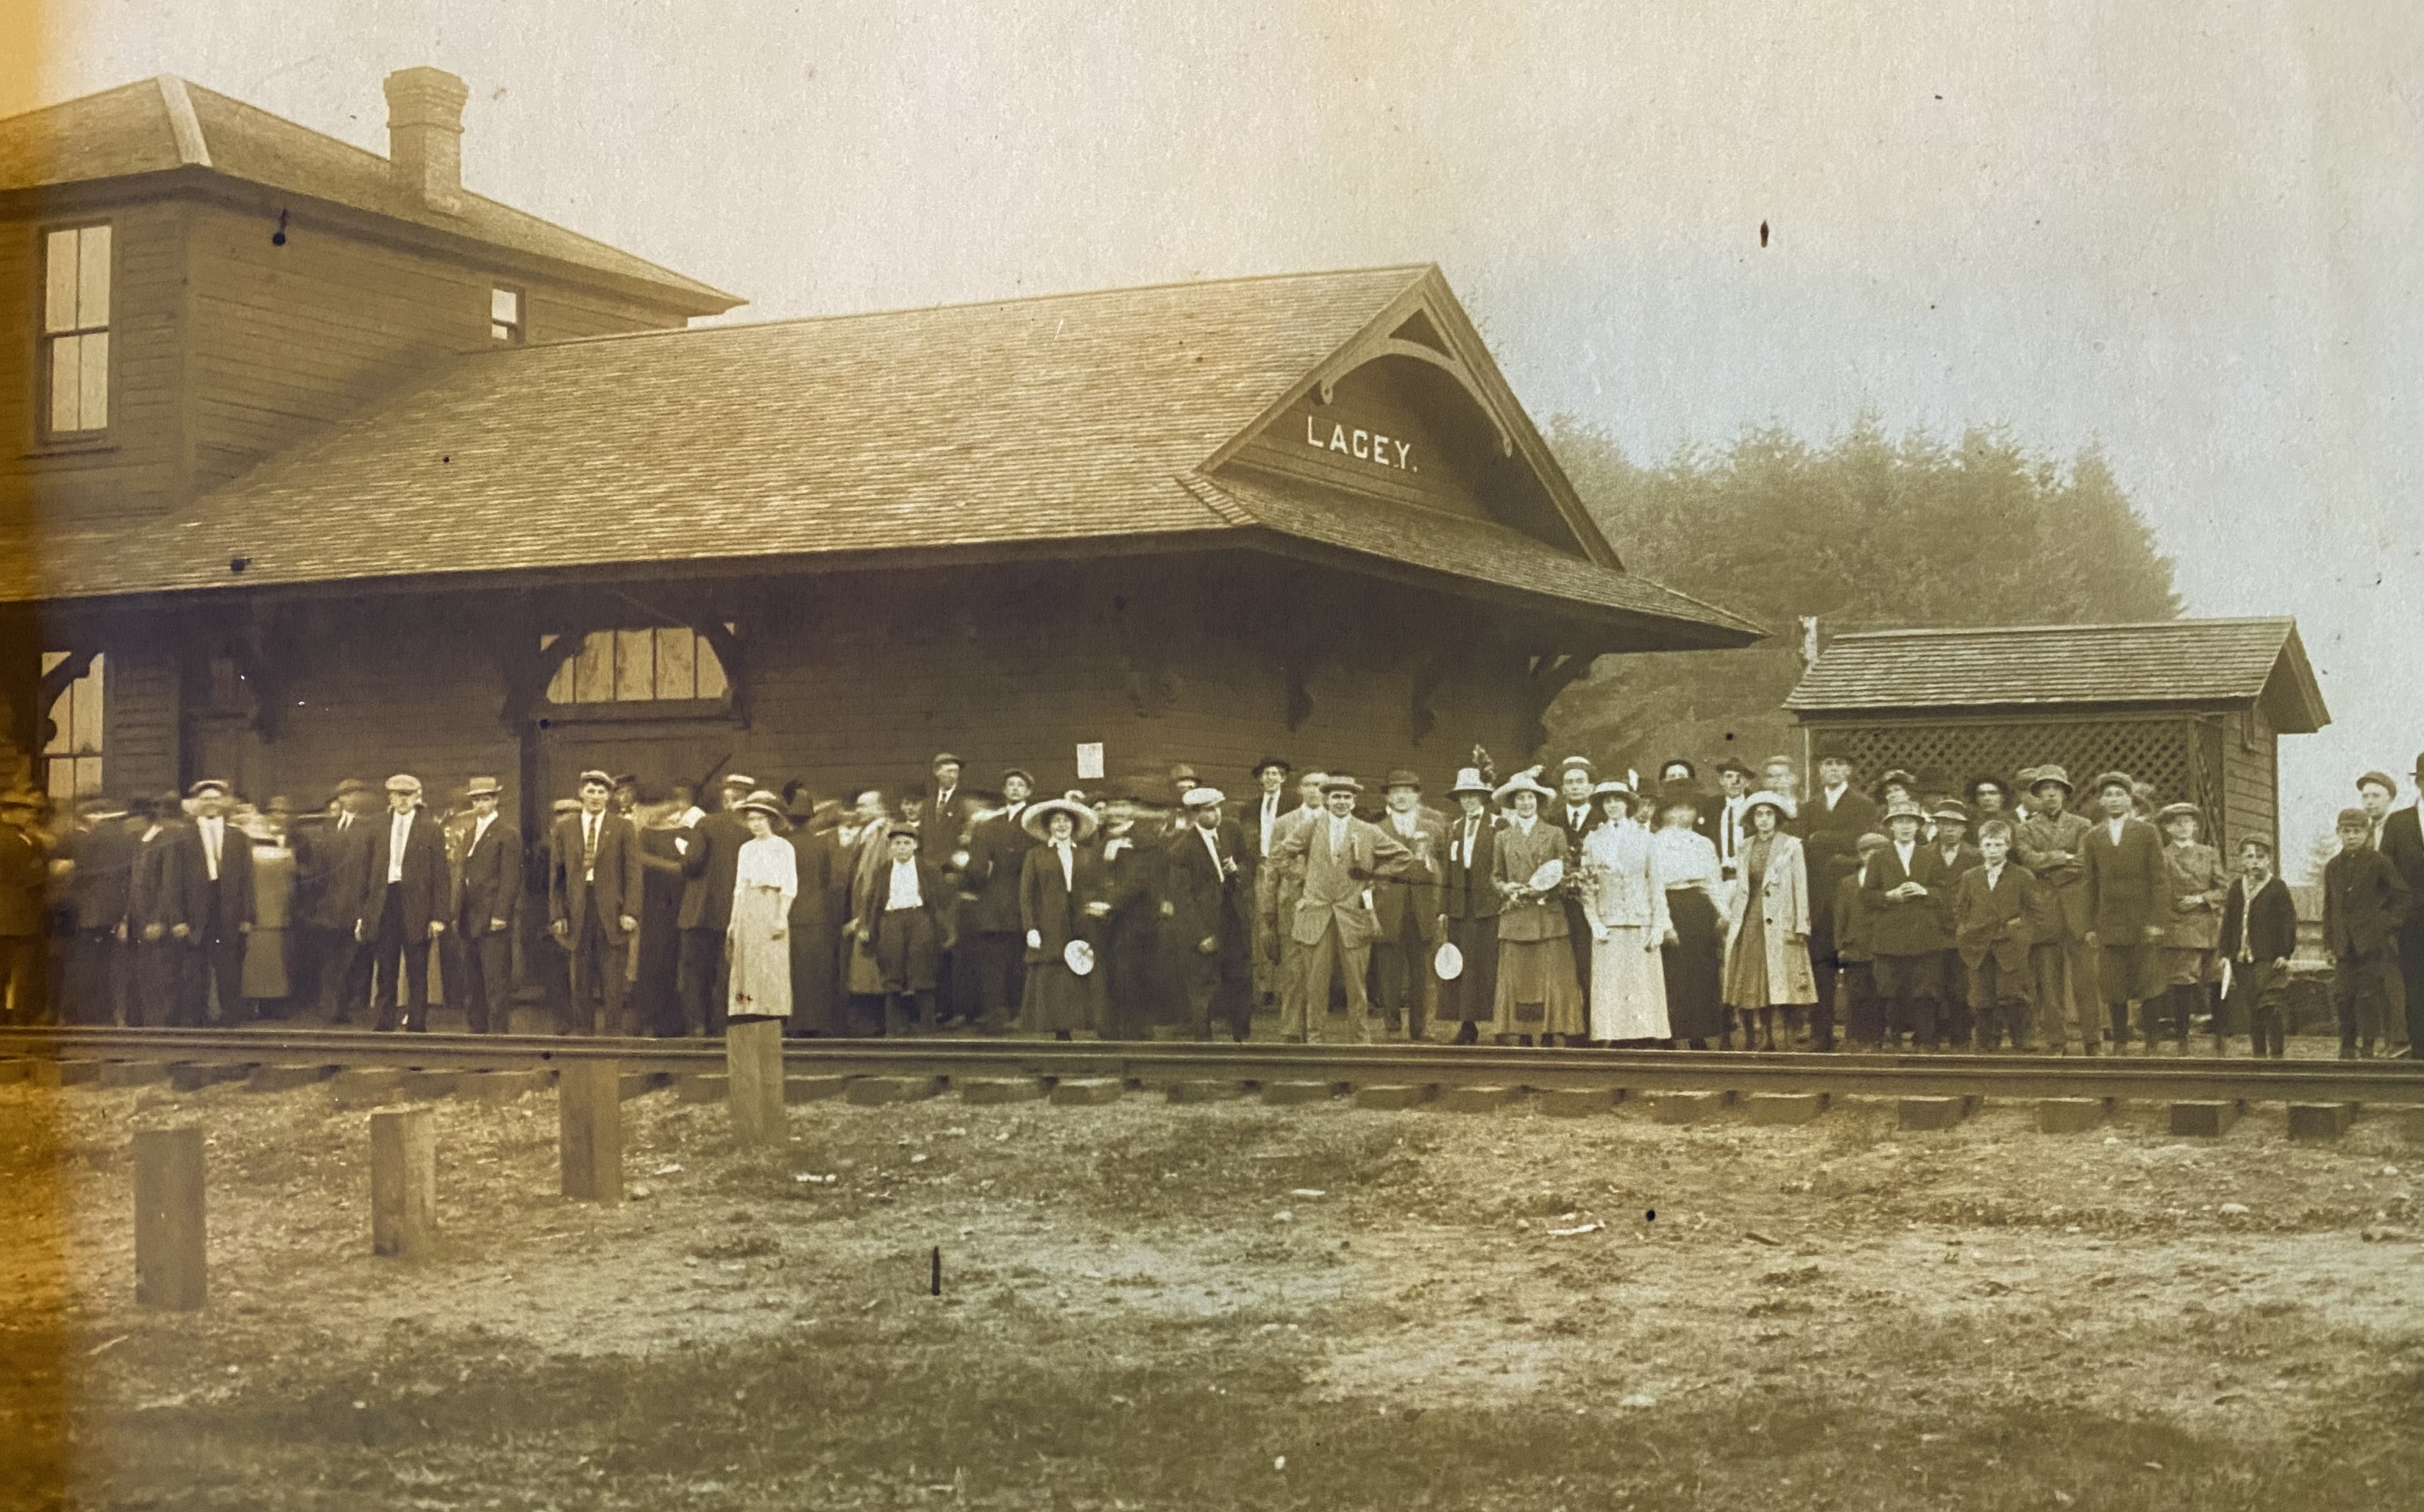
Lacey
NP Depot
1909
Waiting for President William Howard Taft
(Courtesy Washington State Historical Society - C1968.52.1)

Slide 27
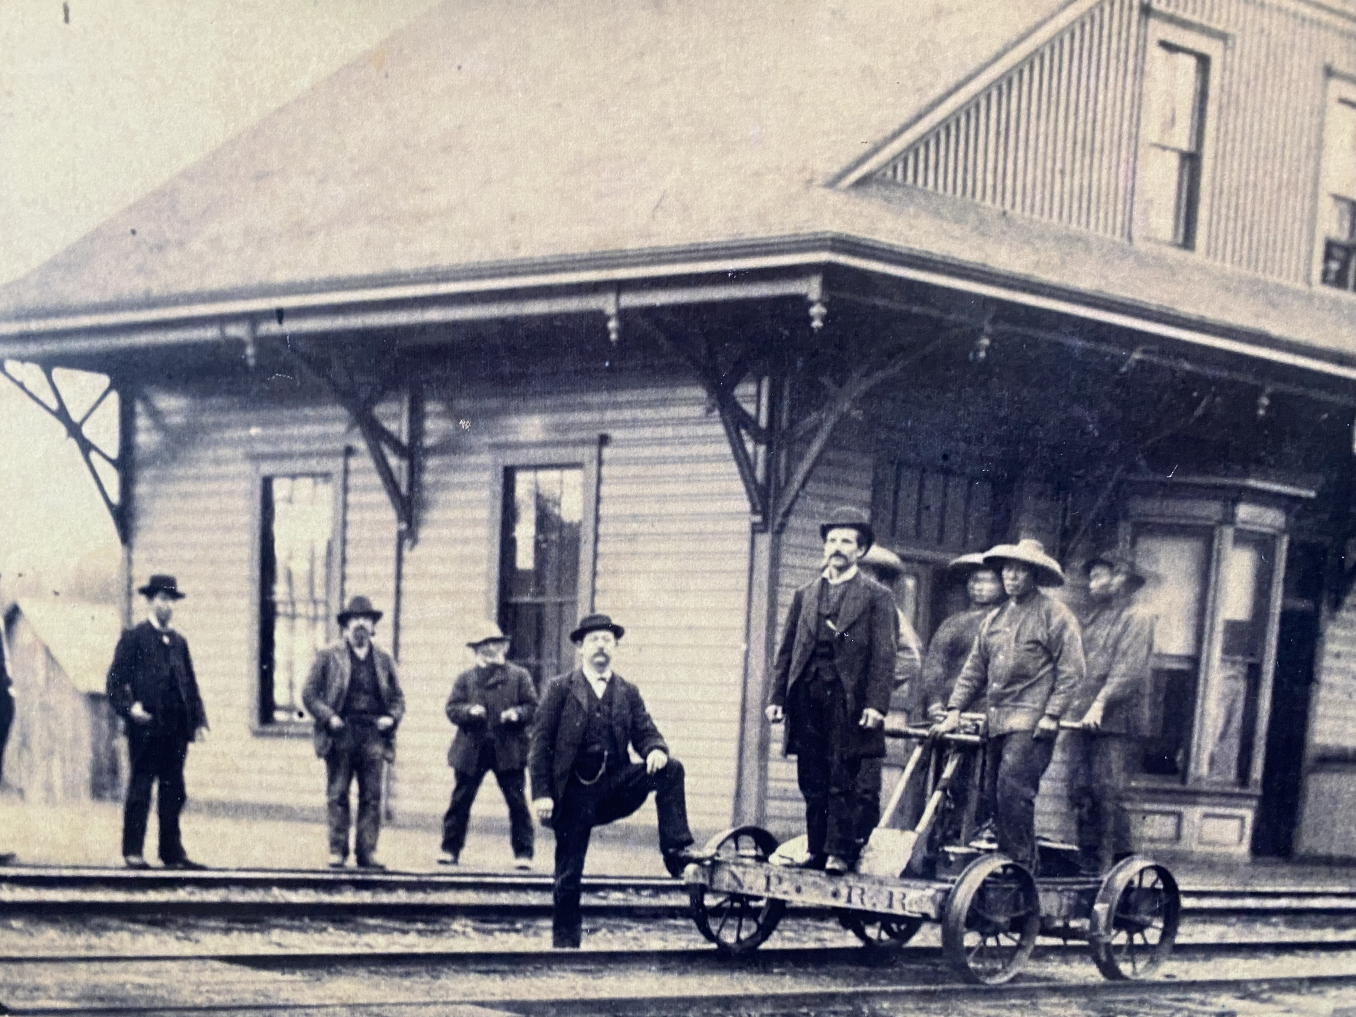
Tenino
I appreciate the assistance of Tenino Historian Rich Edwards for locating and identifying this photo believed to be taken by Hiram Hoyt, Seattle, between 1876-1878.

Slide 28
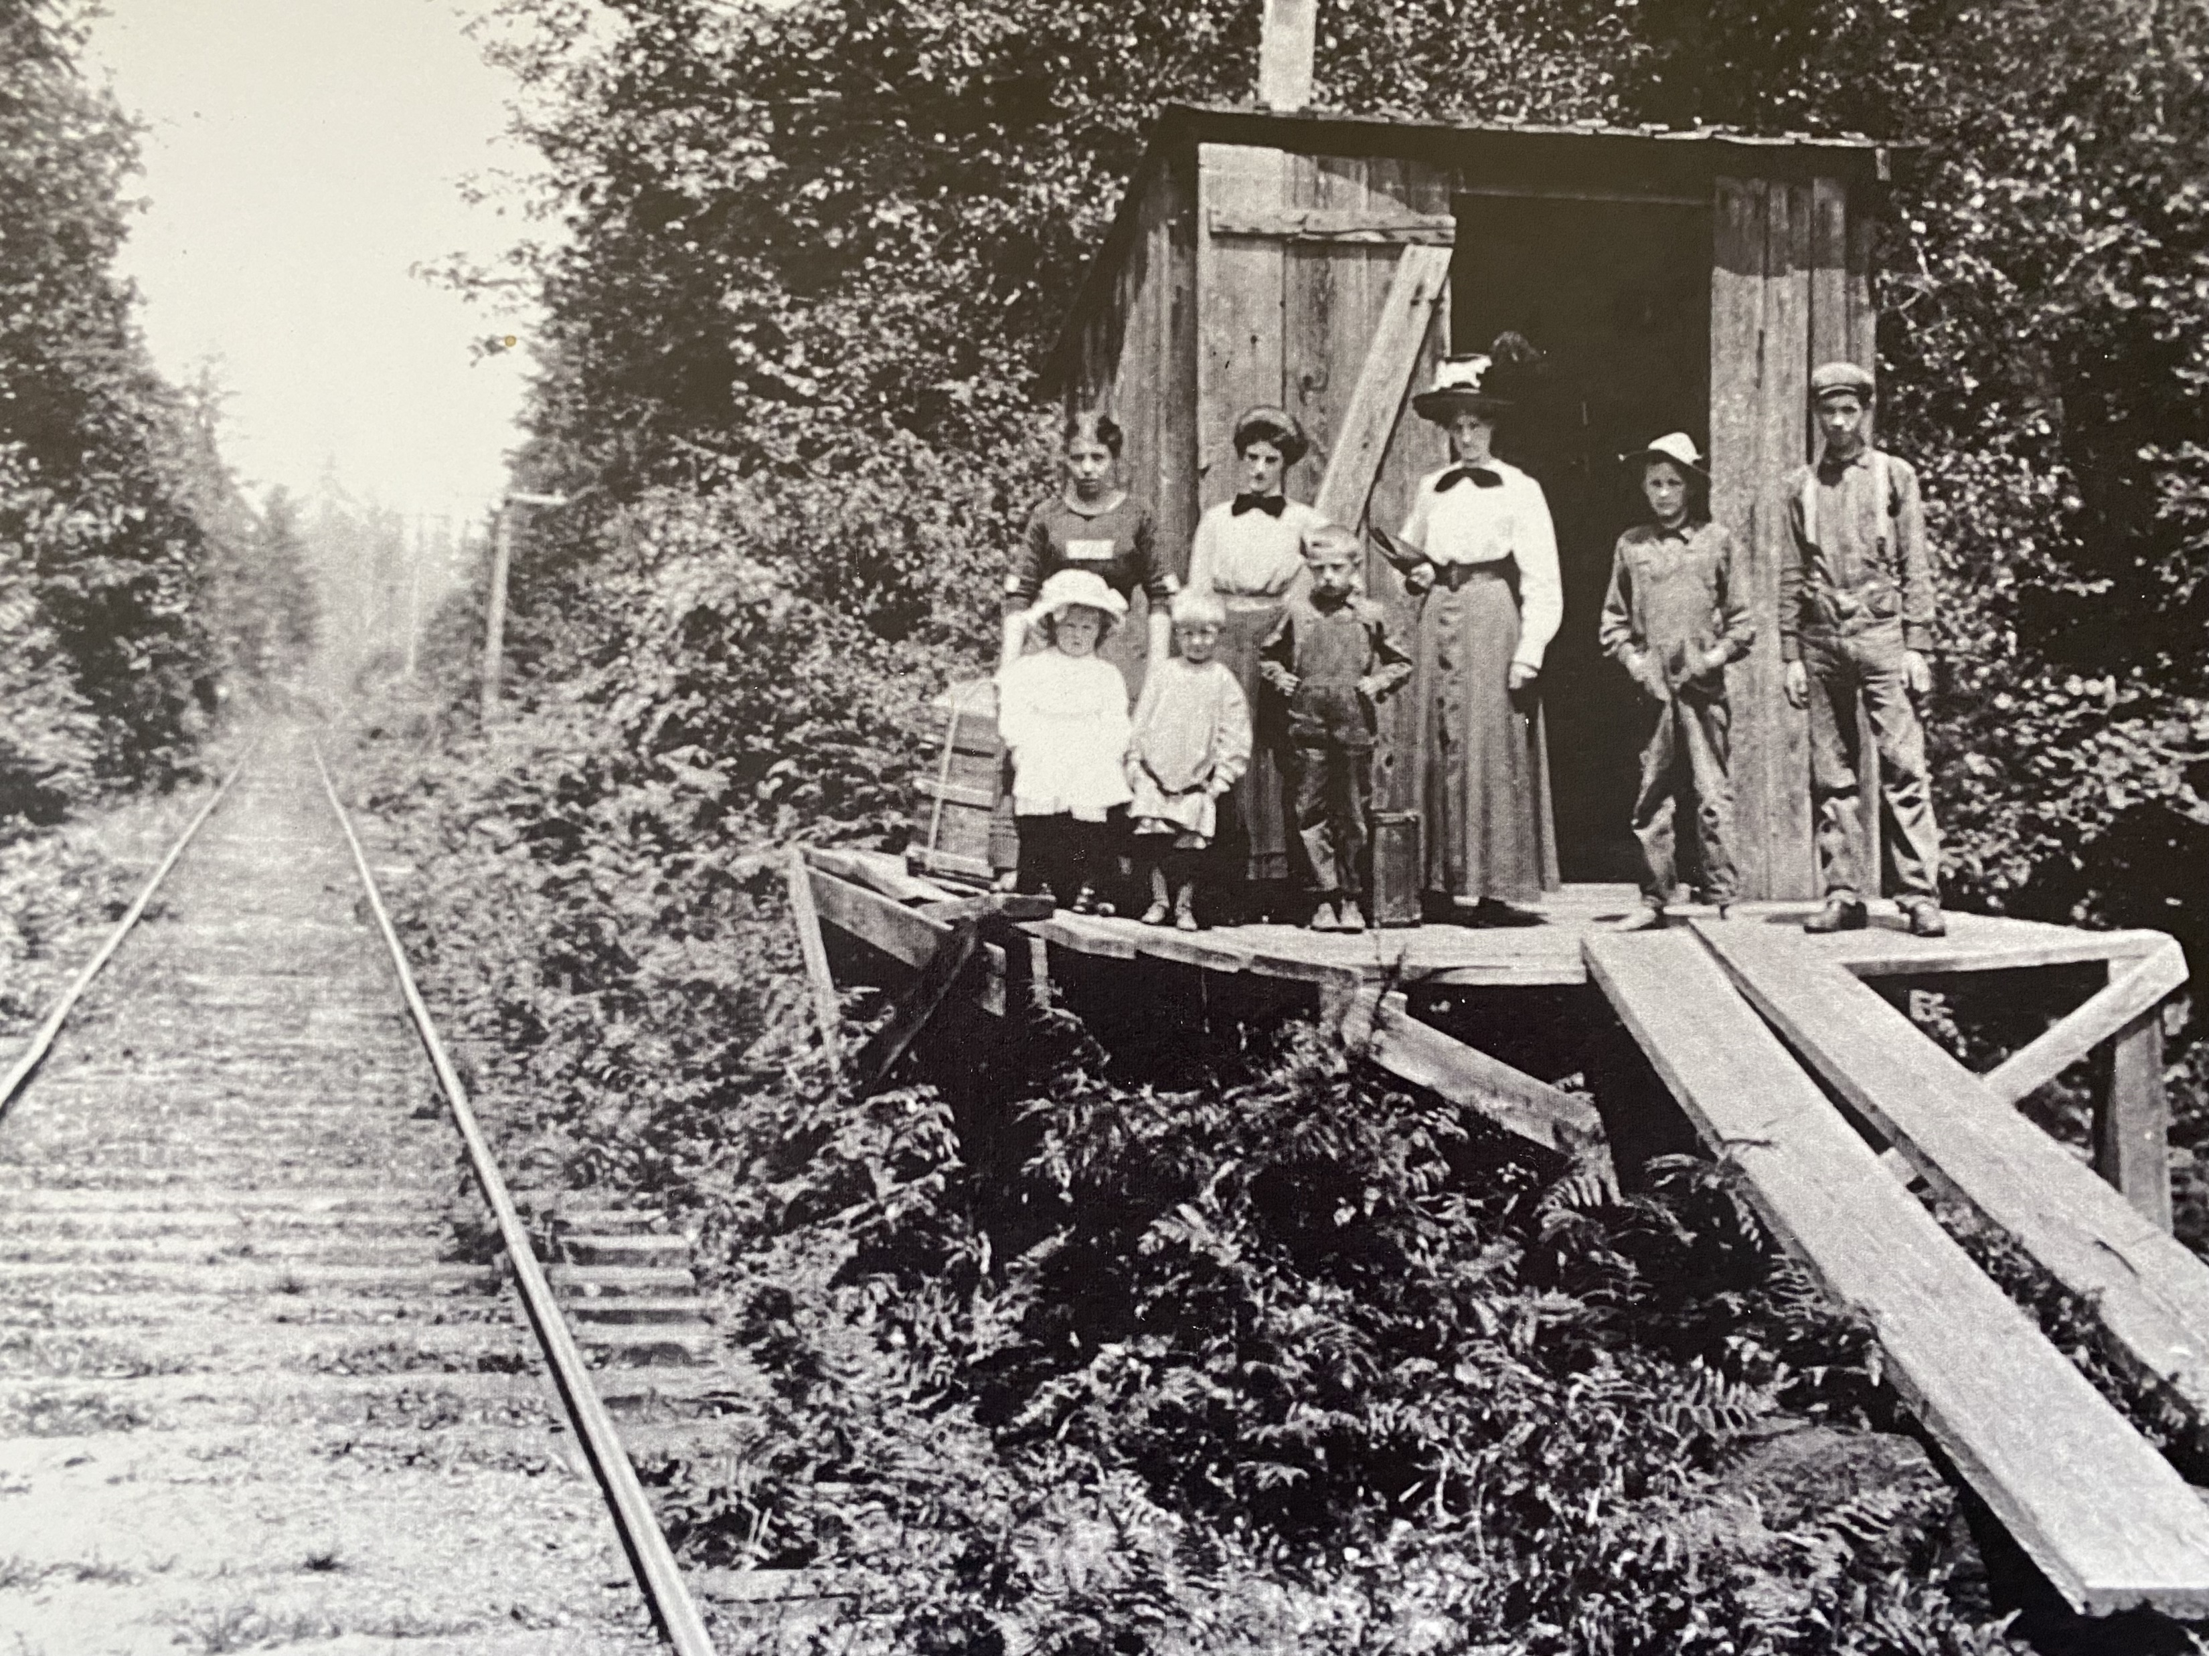
Sheldon Stop
Sheldon Station on the Olympia-Tenino Railroad. Address is about 9600 Highway 99, Tumwater. With NPs decision to build track to Tacoma from Tenino, Olympia interests built this track (initially narrow gage) from Tenino to what is now Capitol Lake in 1877.
Also known as the Olympia and Chehalis Valley Railroad before acquired by Northern Pacific. Some of those pictured are believed to be members of the Sheldon Family including children Lena, May and Earl.
Thanks to Ron Nelson for his assistance

Slide 29
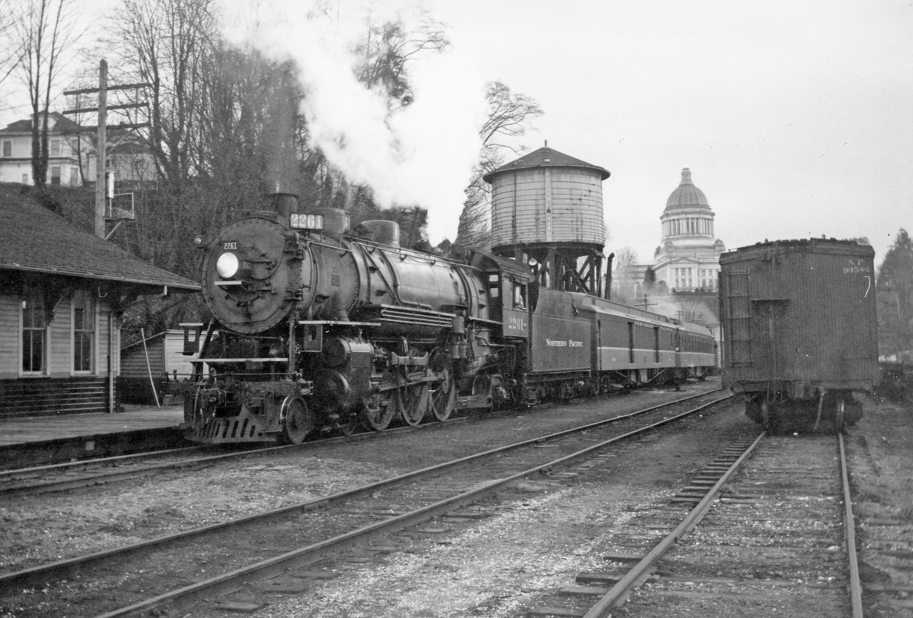
Olympia
NP Station
Feb. 13, 1956
Station Building
1891-1966

Slide 30
Olympia
NP
Seattle to Hoquiam train at Olympia Northern Pacific station Feb. 14, 1956.
Photo by Jim Fredrickson. Courtesy Washington State University Press. Published in "Railscapes: A Northern Pacific Brasspounder’s Album

Slide 31
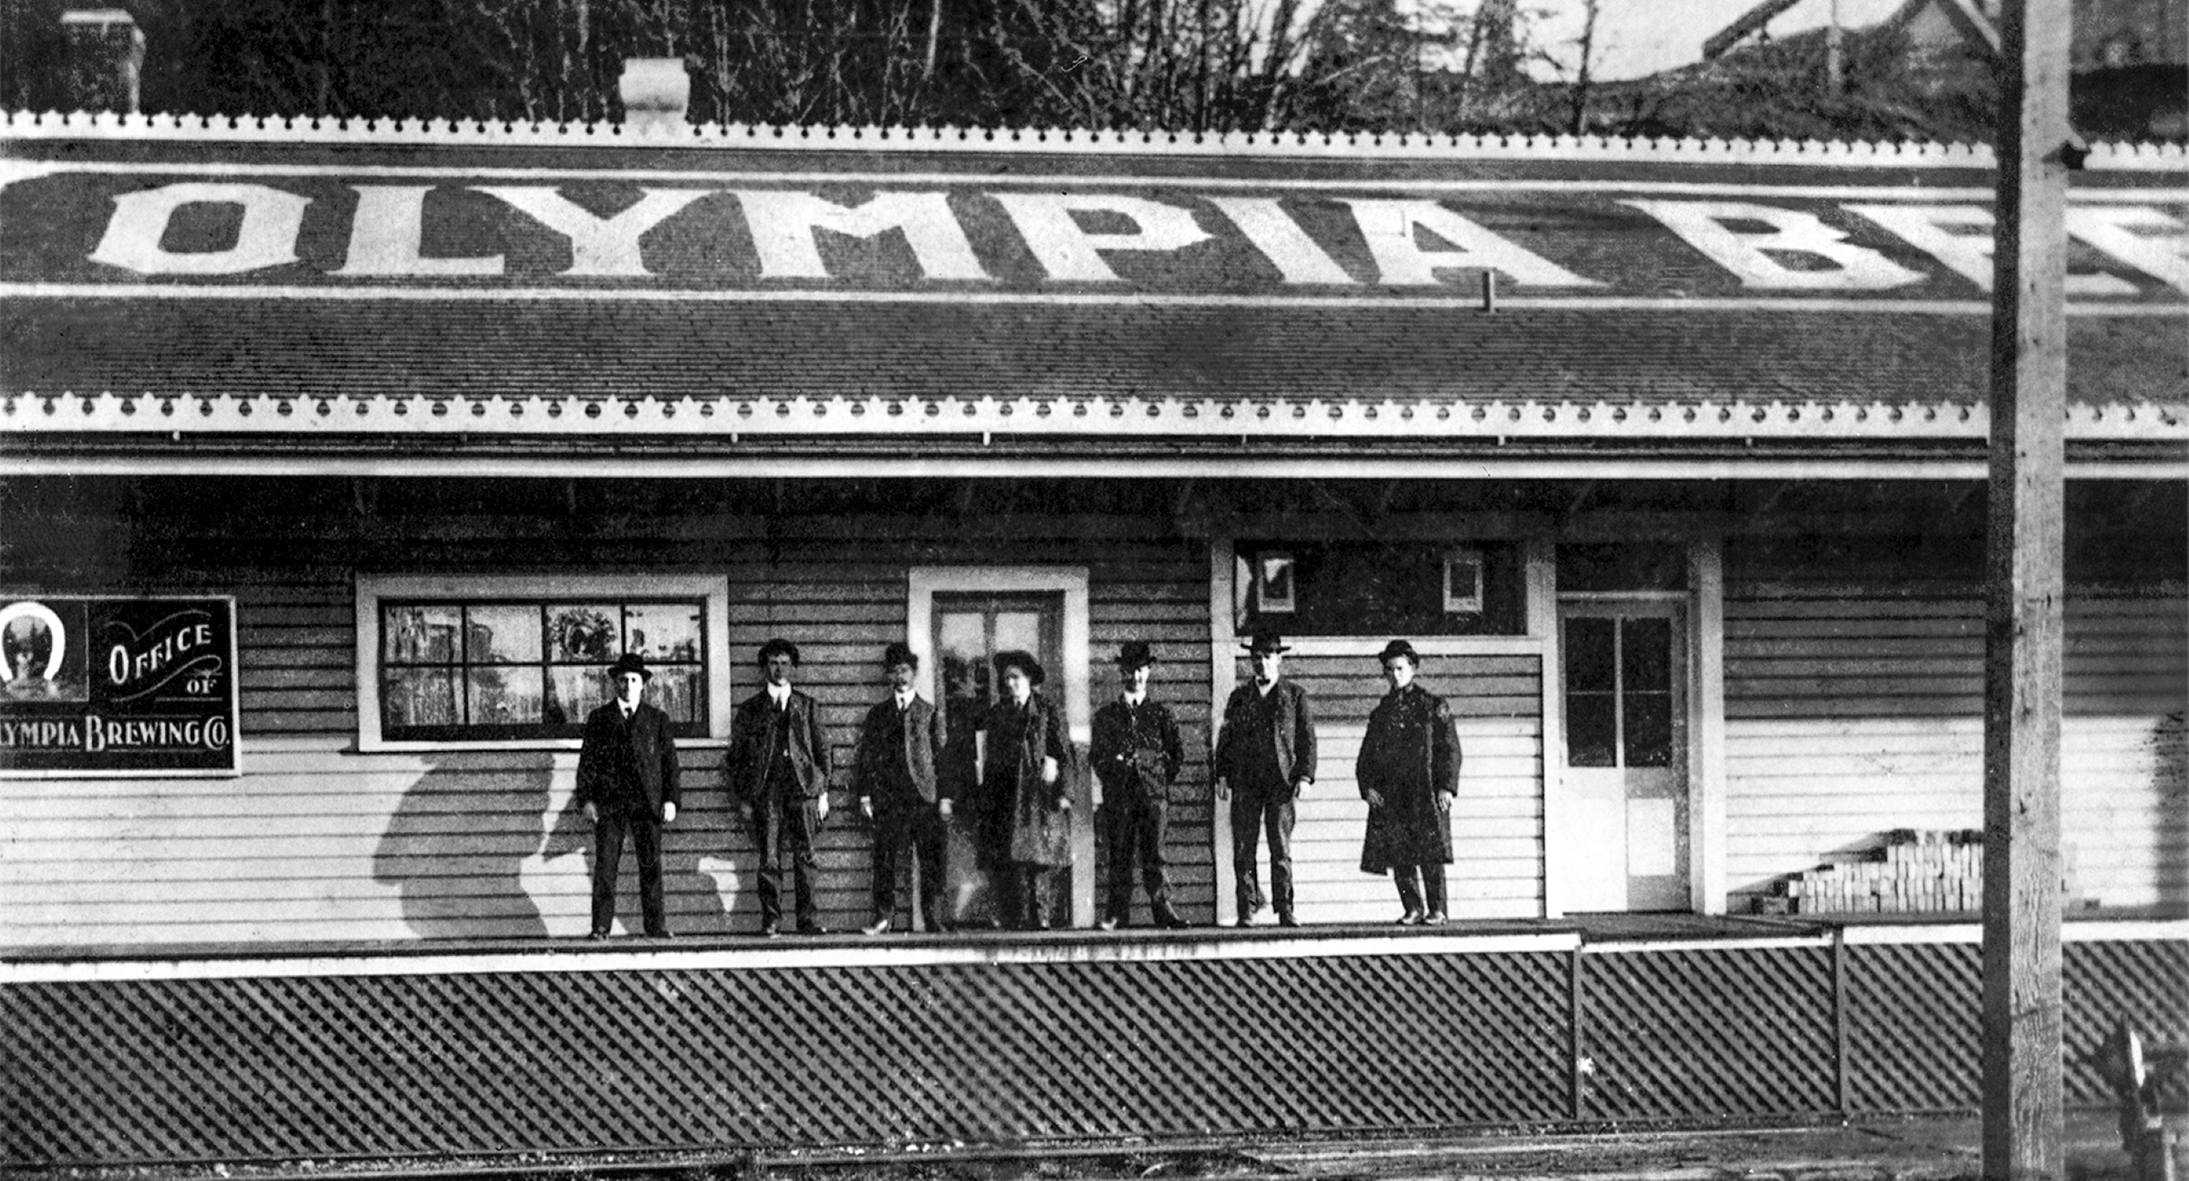
Olympia Brewery Train Depot
Joe Jeffers Photo
Susan Parish Collection
Near NP Station

Slide 32
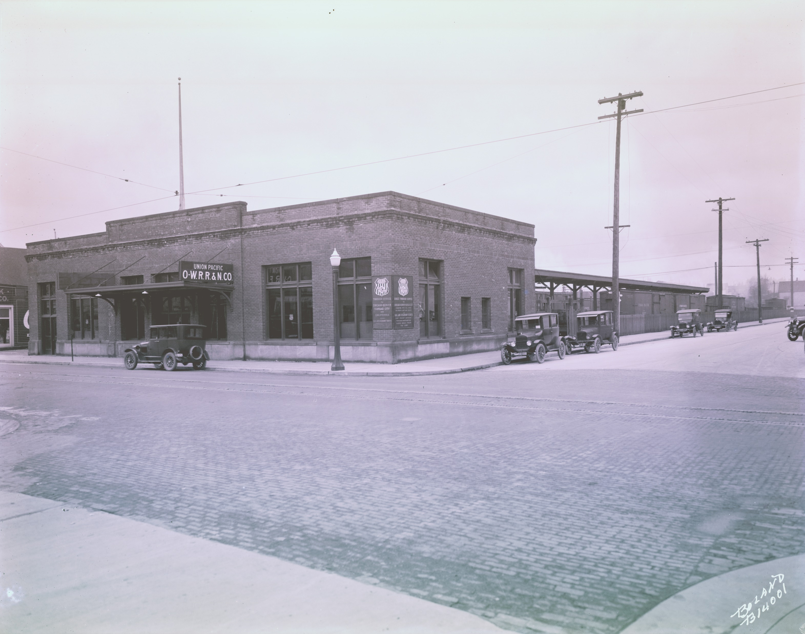
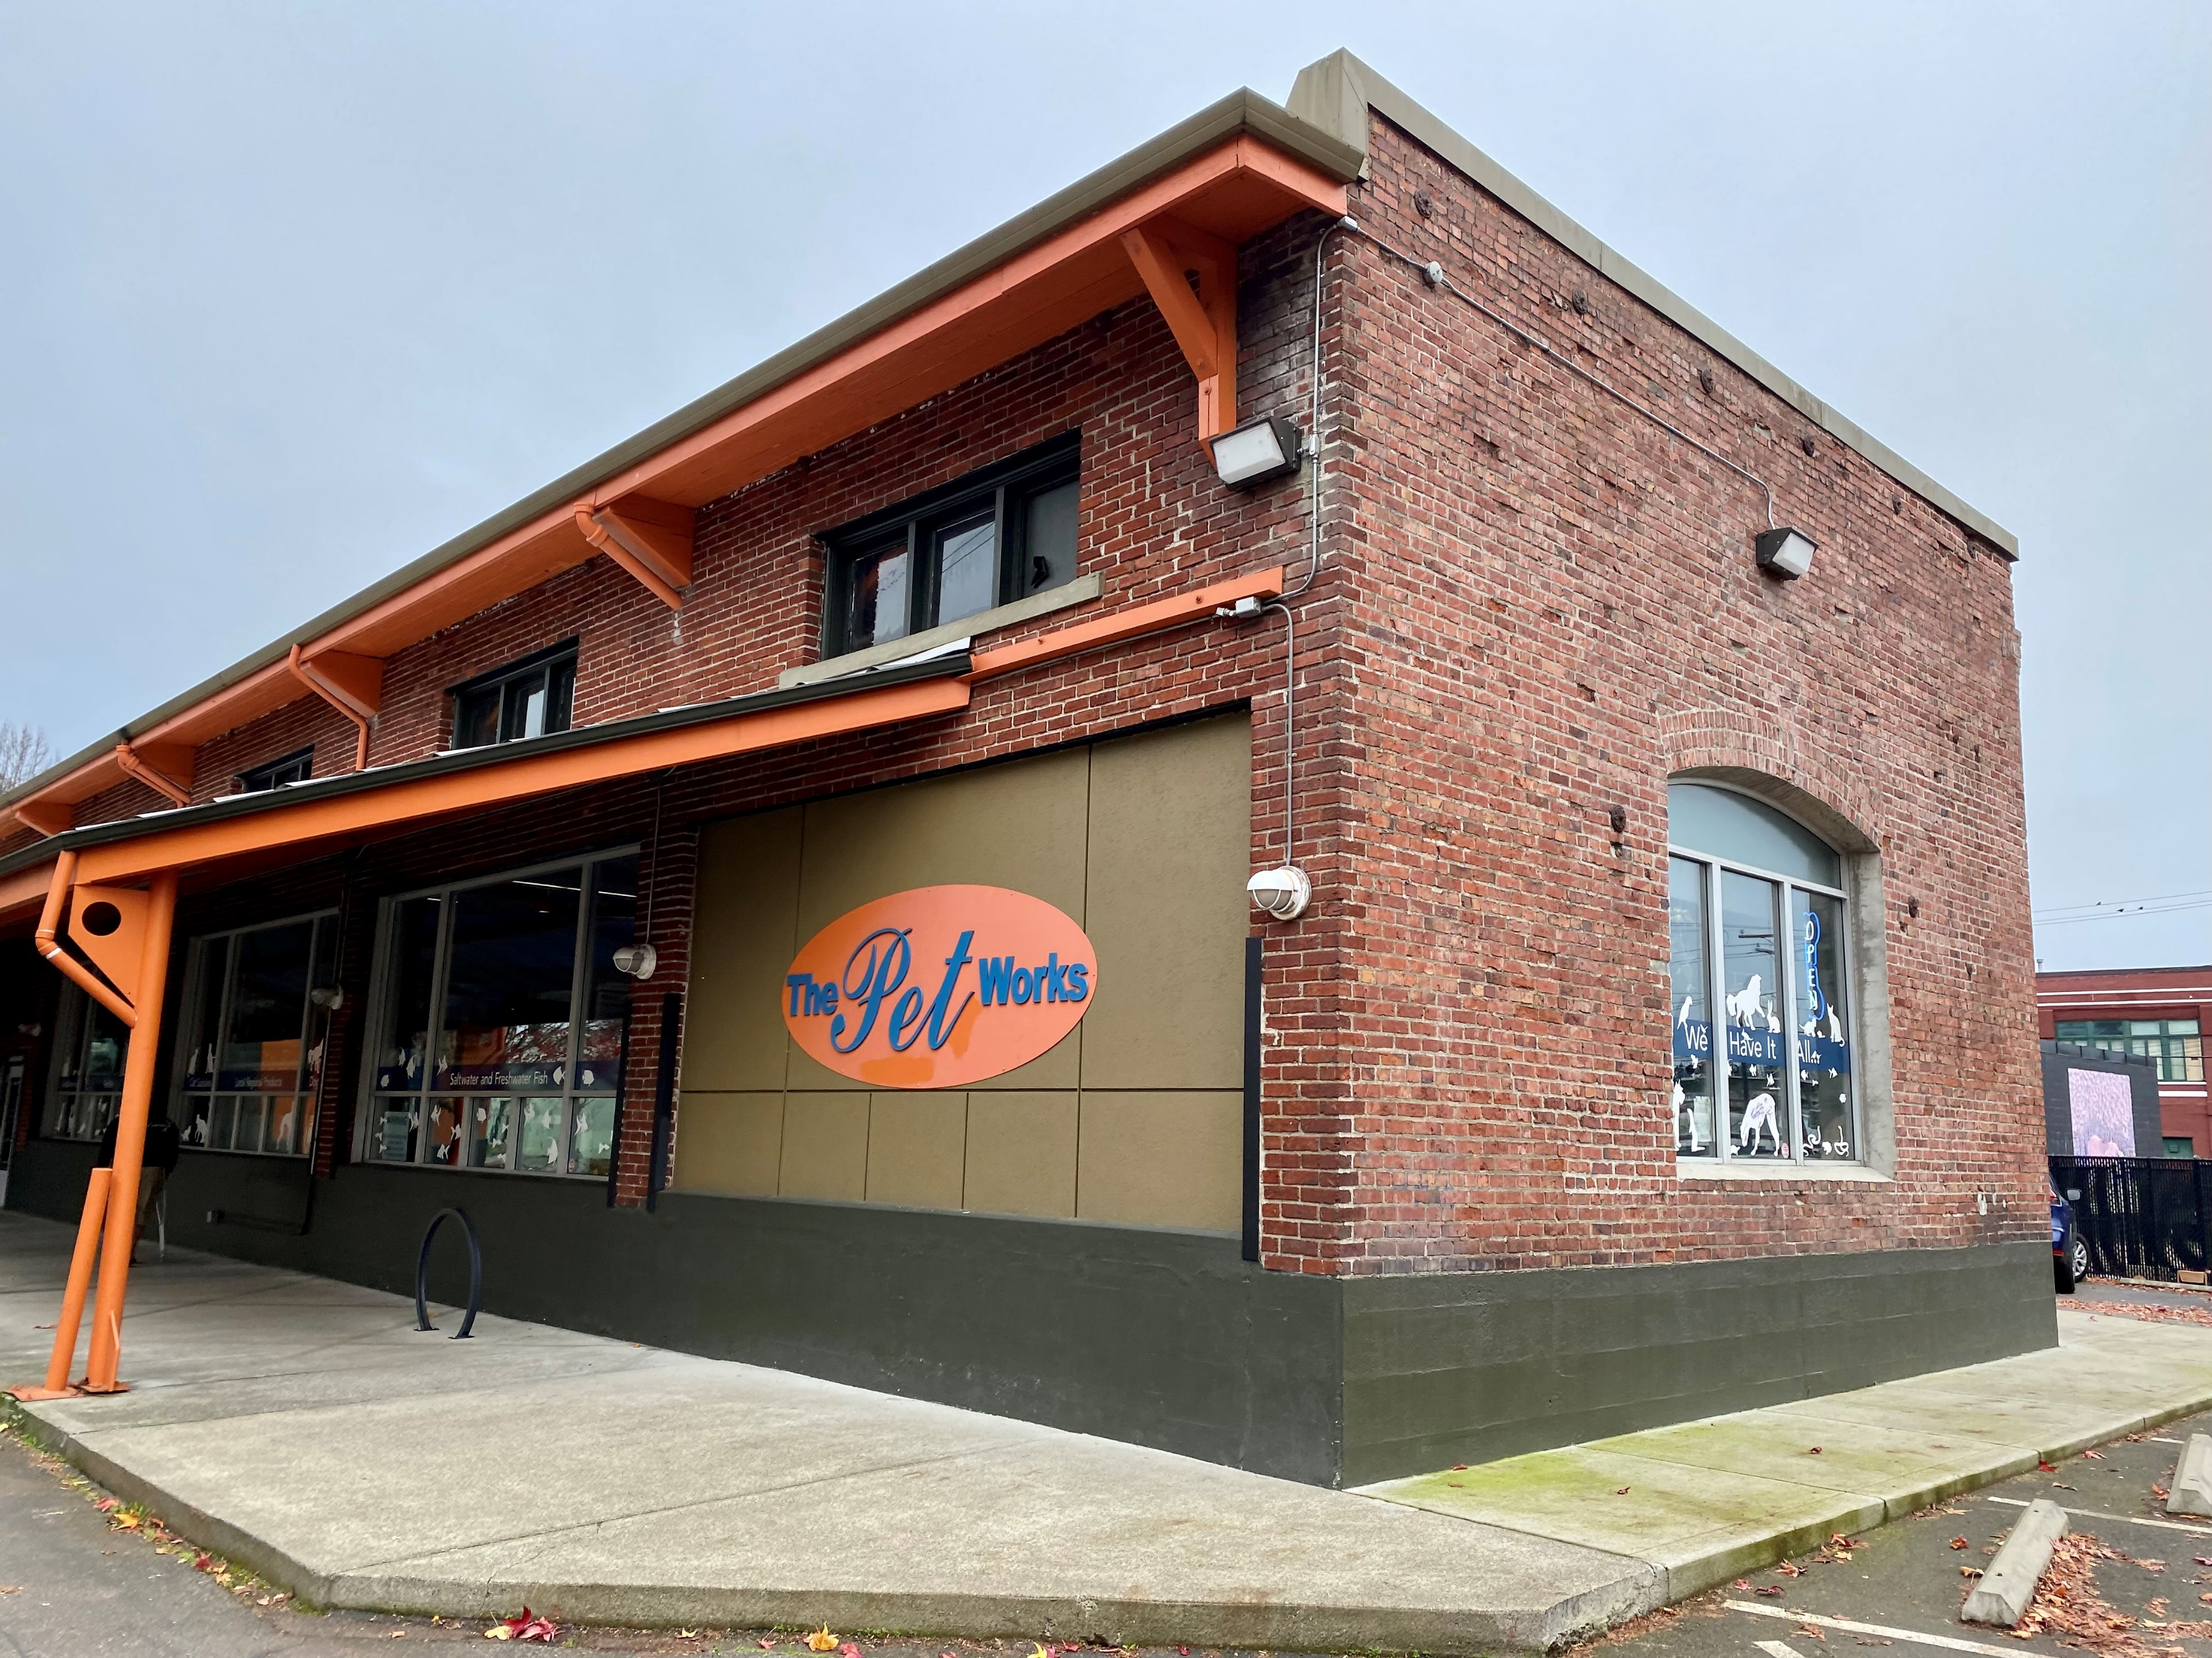
Olympia UP Depot
Oregon Washington Railroad and Navigation Co.
(Union Pacific)
Olympia Depot
Building Still located downtown today as a pet store.

Slide 33
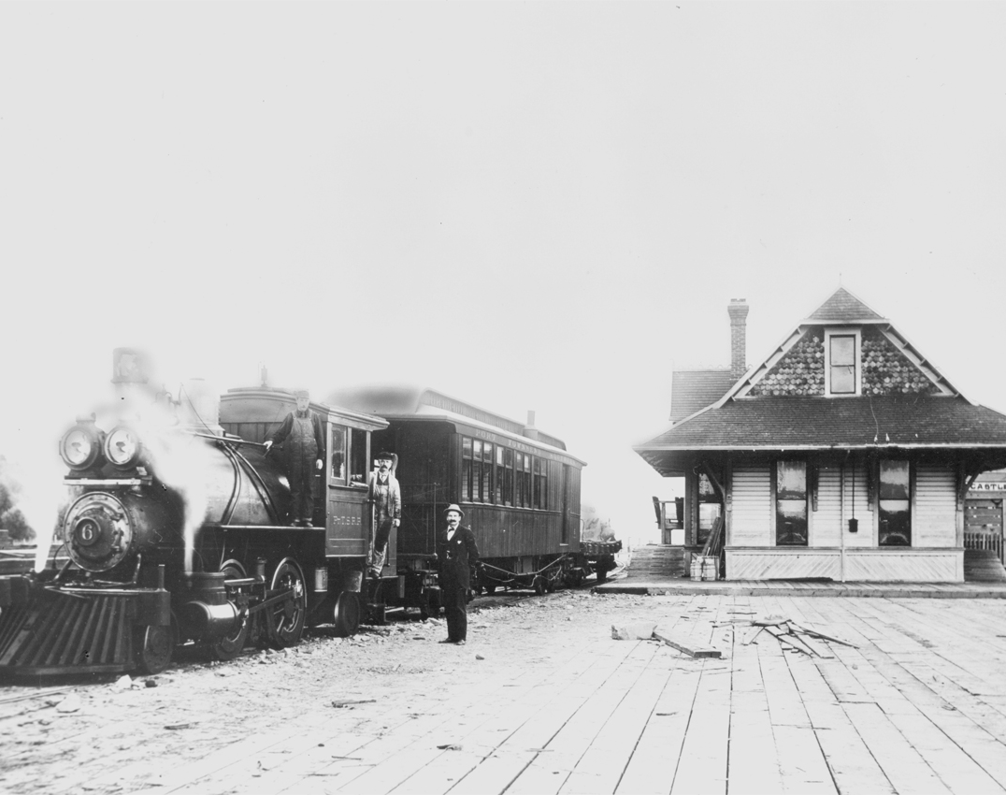
Port Townsend Southern
Near 4th Avenue Bridge
1901

Slide 34
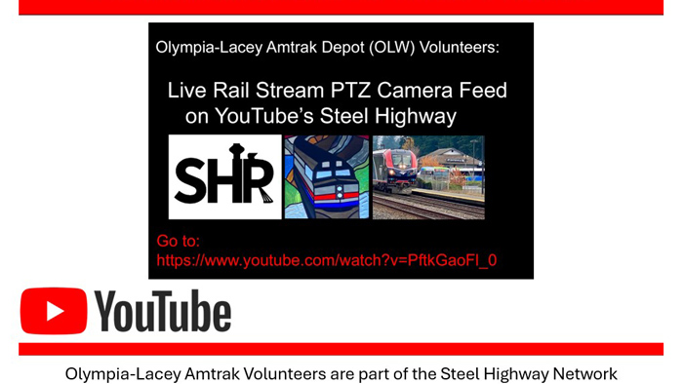

Slide 35
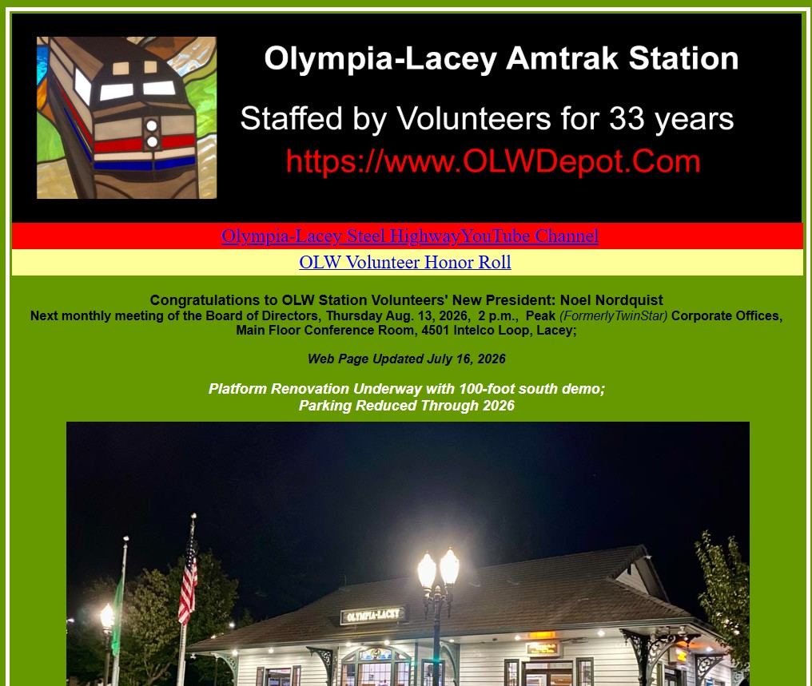
Our Station on the Web
OLWDepot.Com

